Slide 1



UFR Sciences de la Vie et de l'Environnement
Master de biologie, écologie et évolution, parcours modélisation en écologie
Predicting earthworm diversity and distribution:
A comparative approach at national scale using multiple modeling algorithms
Abdourahmane DIALLO
Laboratory
UMRS 6553 ECOBIO, Univ.Rennes – CNRS
Agrosup Dijon &
UMR 1347 Agroécologie (INRAE de Dijon
Internship supervisor
Daniel CLUZEAU,
Kevin HOEFFNER
Walid HORRIGUE
Internship from january 01 to june 30, 2024

Slide 2
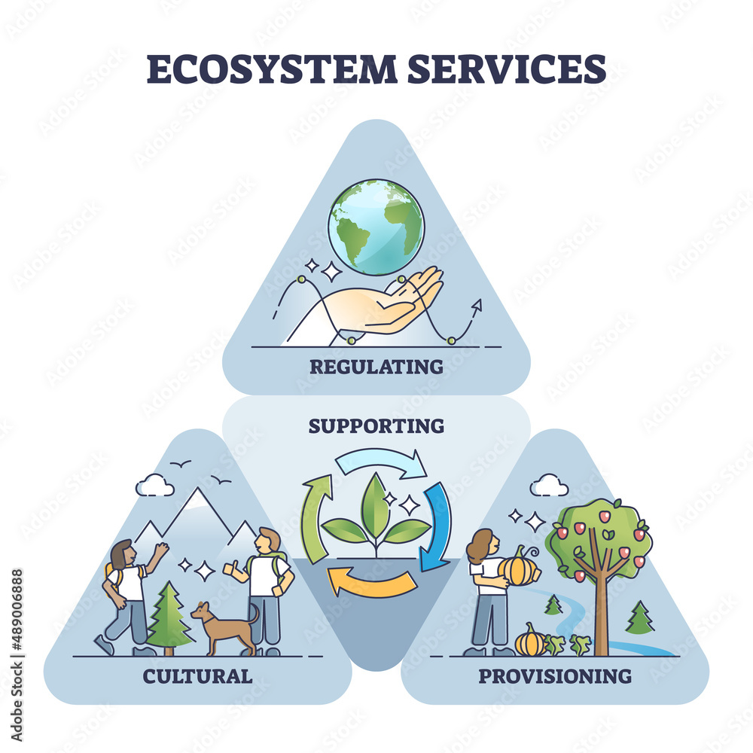
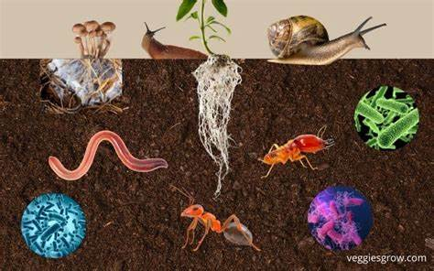

Introduction
Soil fauna

Slide 3

Introduction
Soil fauna
Soil structure
(Bouin et al., 2013; Edwards & Arancon, 2022)
Earthworms
«Ecosystem engineers»
(Brown et al., 2004)
Nutrient cycle
(Lemtiri et al., 2014, van Groenigen et al., 2014)
Lumbricus terrestris
Water infiltration
(Capowiez et al., 2014; Cunha et al., 2016)
Notes:
Ils sont aussi des très bon bioindicateurs

Slide 4
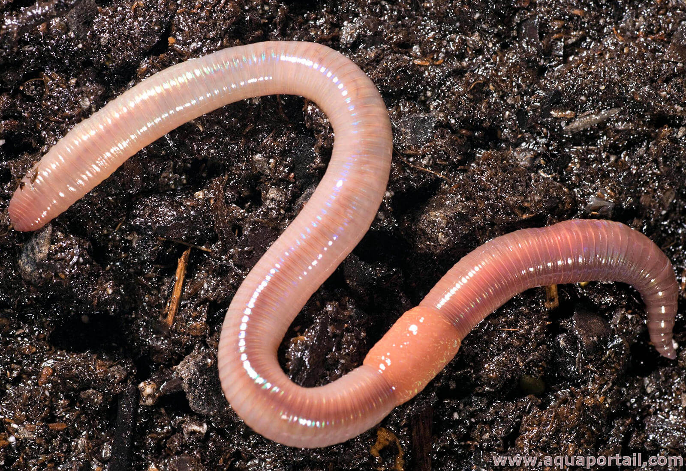
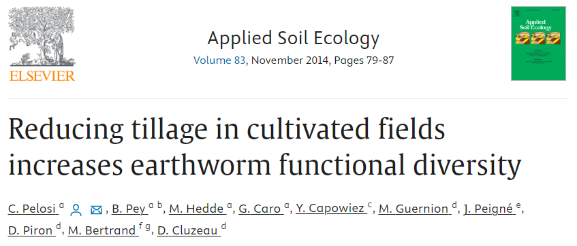
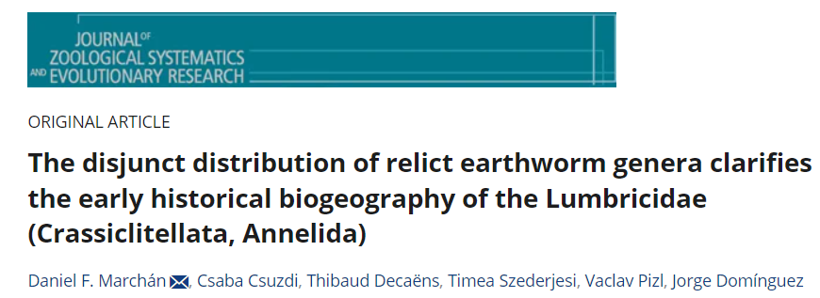
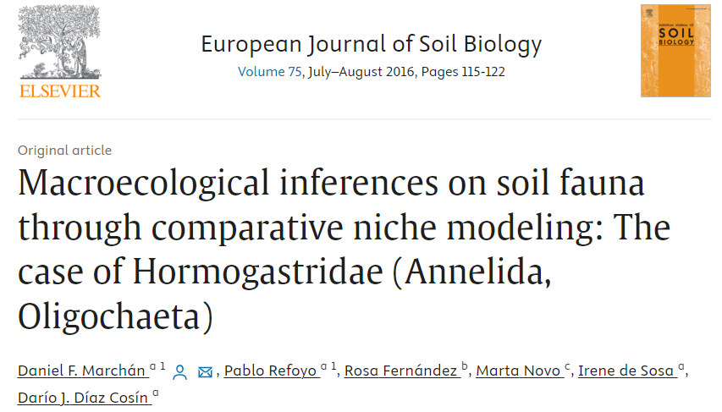
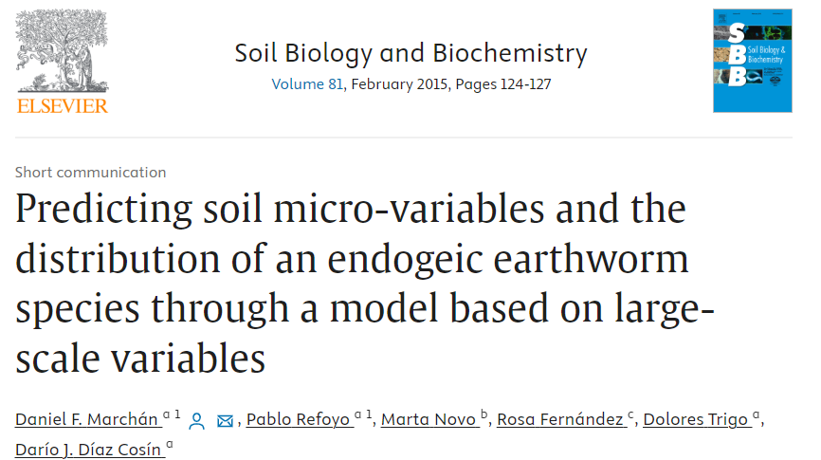
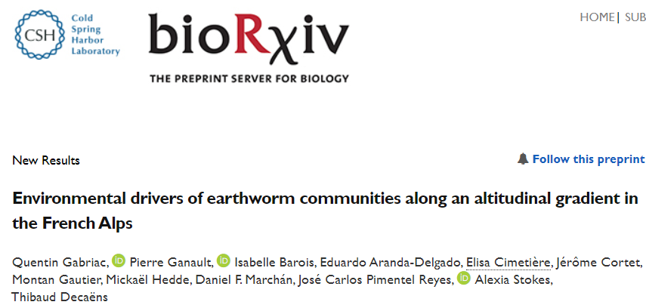
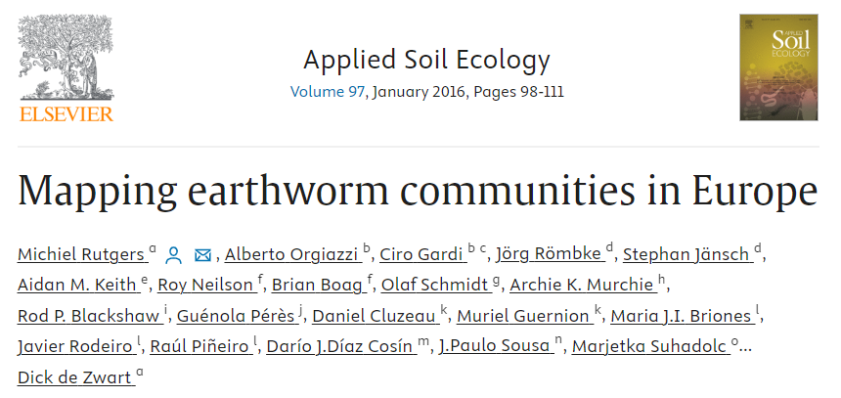
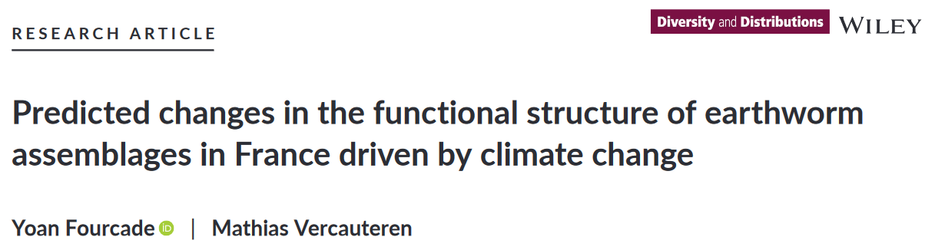
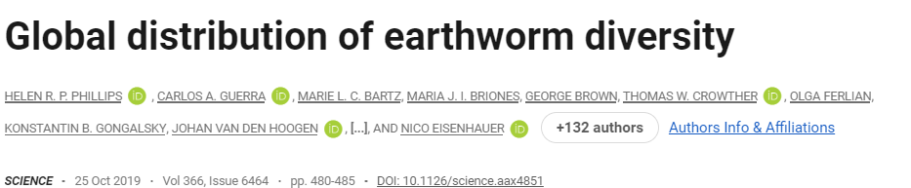
Introduction
Effects of anthropic and environmental factors on earthworms
Continental & Global
(Climate and land use)
National scale ?
Regional scale (soil properties)
Local scale (management practices)
Notes:
Pratiques des gestions

Slide 5
Introduction
Effects of anthropic and environmental factors on earthworms
Continental & Global
(Climate and land use)
National scale ?
Regional scale (soil properties)
Local scale (management practices)
One type of predictive modeling algorithm
Model results vary significantly by modeling algorithms (Elith et al., 2006; Elith and Graham, 2009; Oppel et al., 2012; Li and Wang, 2013)
Notes:
Parler des pratiques des gestions qui sont caché derrière l’occupation du sol

Slide 6
Introduction
Modeling algorithms
SDMs «species distribution models»
Modeling the biodiversity-environment relationship (Elith & Leathwick, 2009; Guisan et al., 2017)
Various SDMs exist, each with its own advantages and disadvantages (Li & Wang, 2013; Valavi et al., 2021)

Slide 7

Introduction
Modeling algorithms
SDMs «species distribution models»
Modeling the biodiversity-environment relationship (Elith & Leathwick, 2009; Guisan et al., 2017)
Various SDMs exist, each with its own advantages and disadvantages (Li & Wang, 2013; Valavi et al., 2021)
Which modeling algorithms are the best for predicting earthworm communities
Comparative approach of multiple SDMs (Salako et al., 2023)
Reduce the uncertainty associated with predictions
Identify the best model for each earthworm’s parameters (abundance, biomass, and richness)

Slide 8
Introduction
Modeling algorithms
Traditional regression algorithms
Generalized Linear Models (Rutgers et al., 2016)
Generalized Additive Models (Salako et al., 2023)
Machine learning algorithms
Random Forests (Salako et al., 2023)
Generalized Boosted Models (Fourcade & Vercauteren, 2022)
Artificial Neural Networks
Widely used in recent studies (Li & Wang, 2013; Rutgers et al., 2016; Valavi et al., 2021; Fourcade & Vercauteren, 2022; Salako et al., 2023)

Slide 9




Introduction
Objectives
Identify the best modeling algorithms for predicting earthworm total abundance (individuals per m²), total biomass (g per m²), and total taxonomic richness (number of taxa in the plot)
Quantify and rank the influence of environmental factors on earthworm parameters
Predict earthworm diversity and distribution in France

Slide 10

Introduction
Objectives
Identify the best modeling algorithms for predicting earthworm total abundance (individuals per m²), total biomass (g per m²), and total taxonomic richness (number of taxa in the plot)
Quantify and rank the influence of environmental factors on earthworm parameters
Predict earthworm diversity and distribution in France

Slide 11


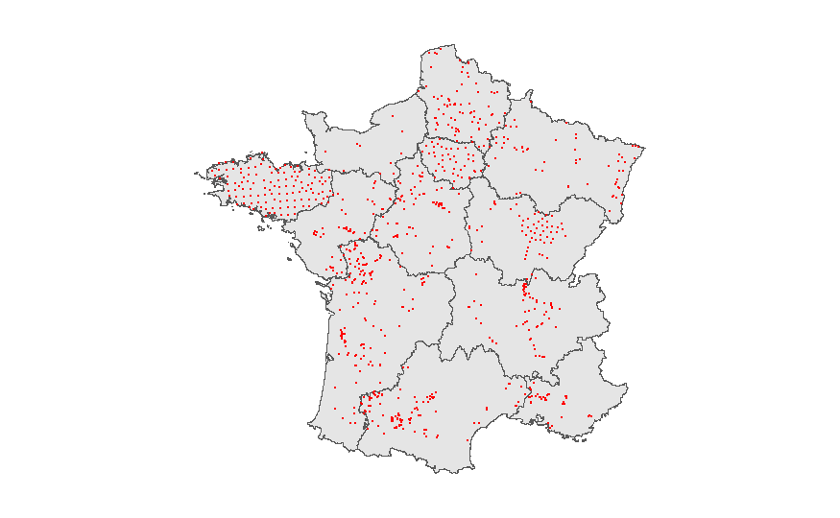
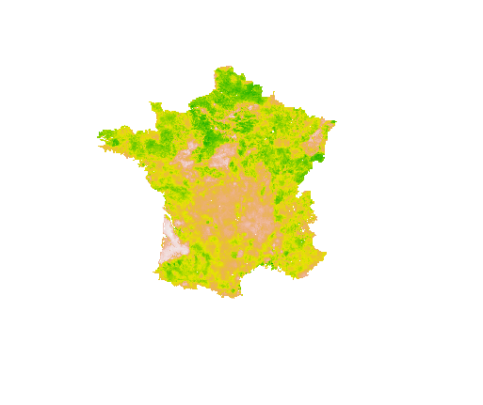
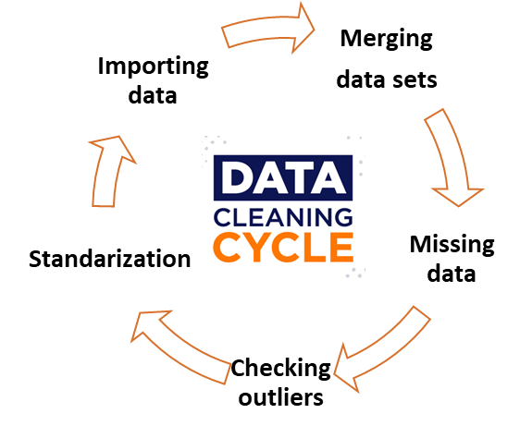
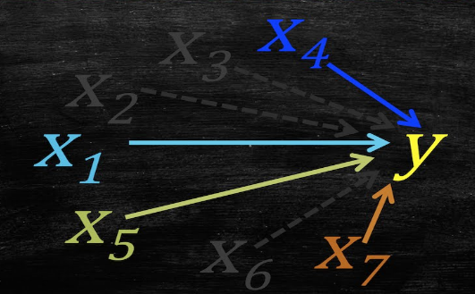
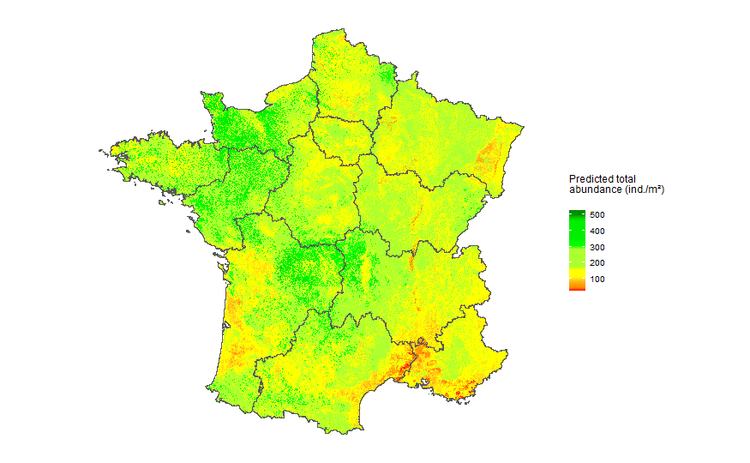
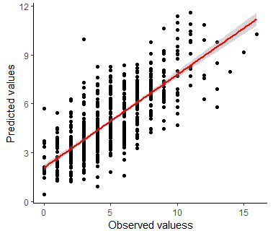
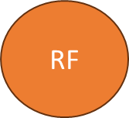
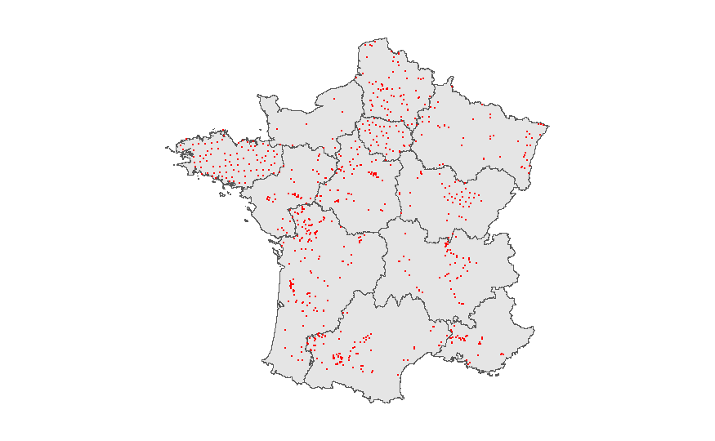
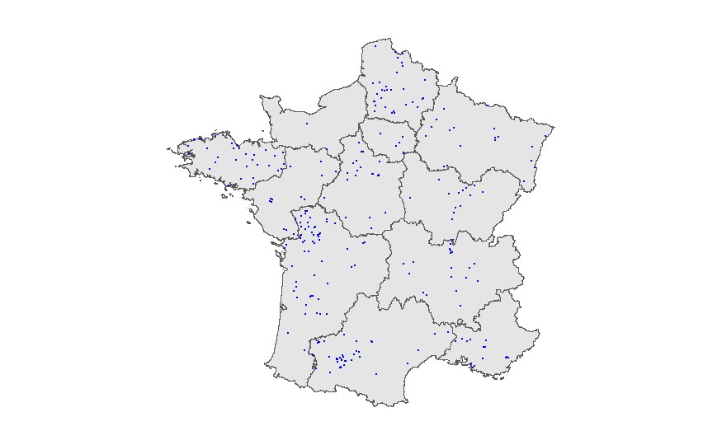
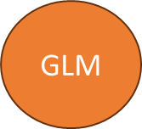
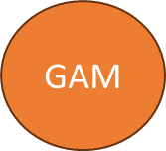
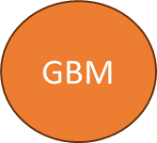
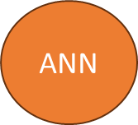
Materials and methods
Modeling strategy
ODMAP protocol: Overview, Data, Model, Assessment, Prediction (zurell et al., 2020)
1. Biological data
2. Environmental data
3. Data cleaning
4. Variable selection
8. Prediction & mapping
7. Evaluation & selection
6. Model fitting & calibration
5. Data partitioning

Slide 12
Materials and methods
1. Collection and selection of earthworm data
LandWorm (2023-2026 FRB-MTE-OFB)
Application of different filters (protocols, land use, …)
3 822 earthworm observations
Between 1990 and 2023
Earthworms’ paramters (abundance, biomass and richness)
GPS coordinates
Land use
12

Slide 13

Materials and methods
2. Environmental data collection
Category | Descriptions | Time scale | Reference | Resolution
Land use | Forest (broad-leaved forest and mixed forest) | 1990 - 2023 | LandWorm database
 | Pastures, meadows and other permanent grasslands under agricultural use
 | Non-irrigated arable land (annual crop, inter crop, market gardening)
 | Green urban areas (urban lawn, ornamental garden, urban allotment garden, urban forest)
 | Vineyards
 | Natural grasslands
Location | Longitude
 | Latitude
Climate | 19 standard bioclimatic variables: annual precipitation, annual temperature,… | 1981 - 2010 | CHELSA (Karger et al., 2017) | 30 arc-second, ~ 800 m
Soil | Silt | 2022 | Roman Dobarco et al., 2022 | 90 m
 | Clay
 | Sand
 | pH | 2009 - 2012 | JRC (Ballabio et al., 2019) | 250 m
 | Calcium carbonates (CaCO3)
 | C/N
 | Carbone content
 | Nitrogen (N)
 | Phosphorus (P)
 | Potassium(K)

Slide 14
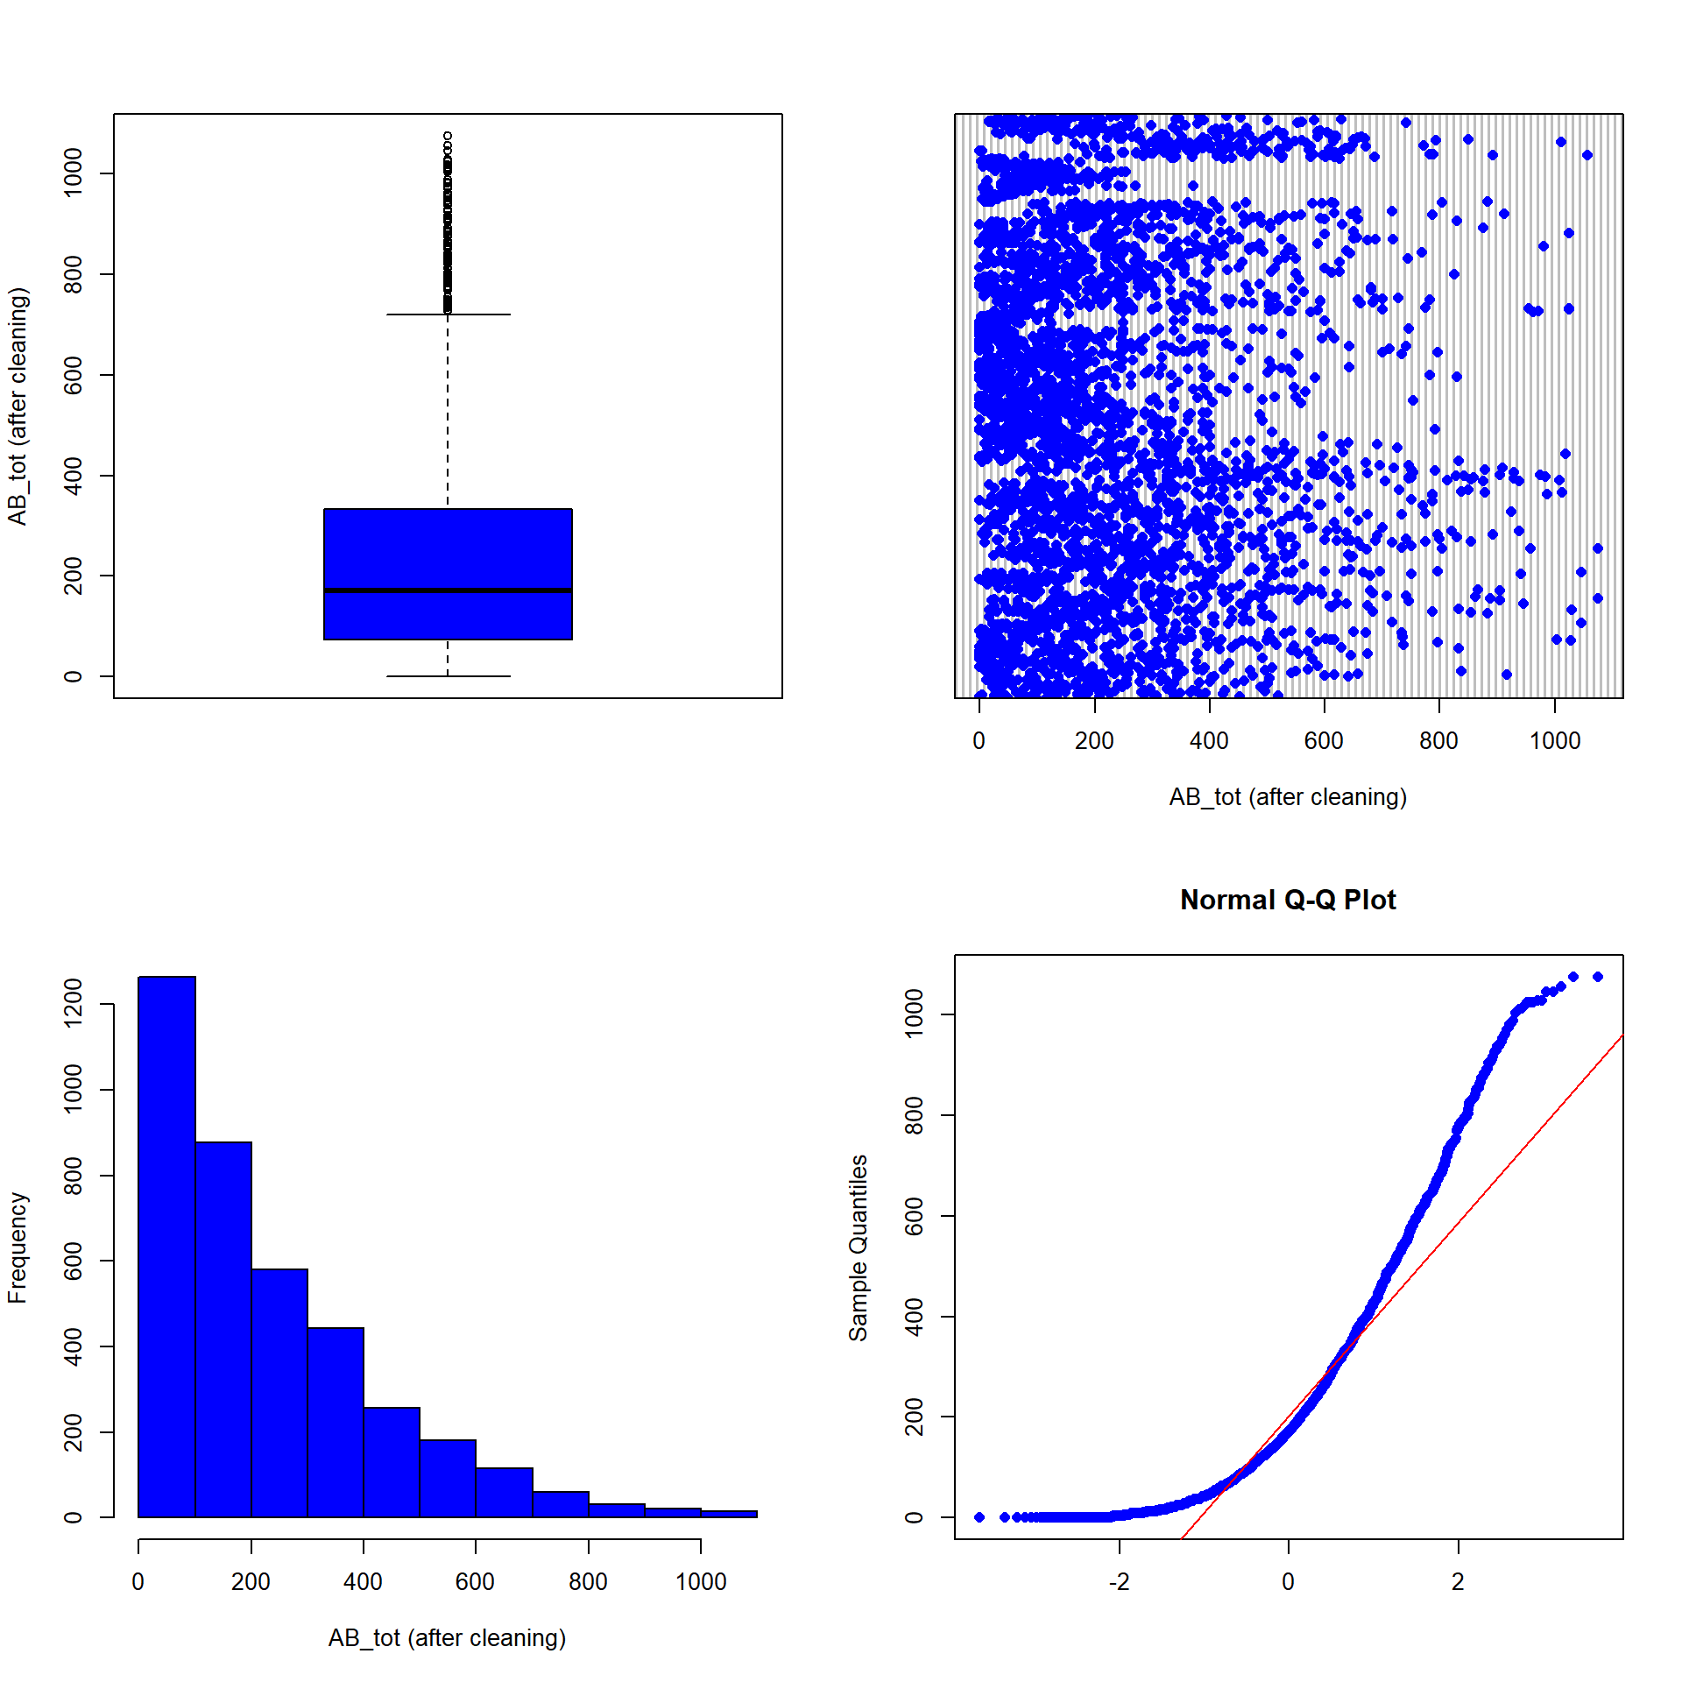
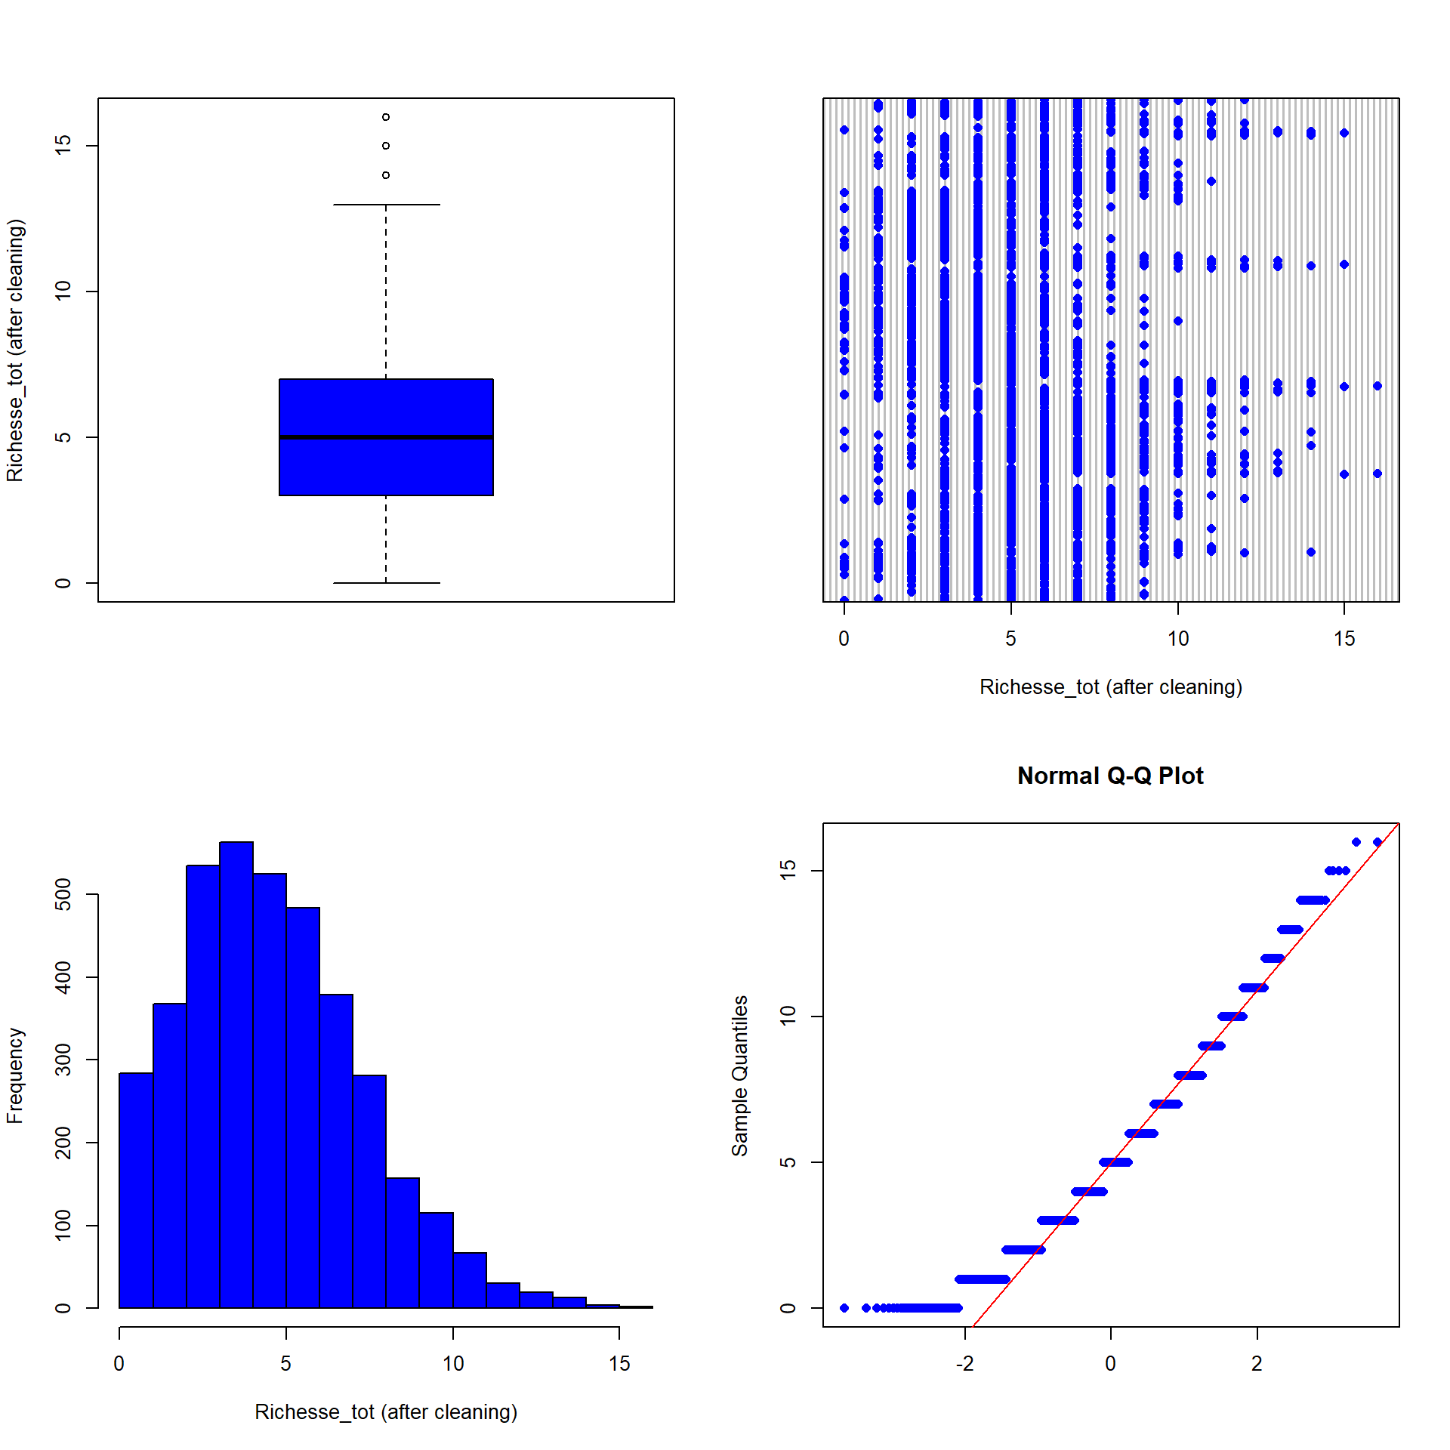

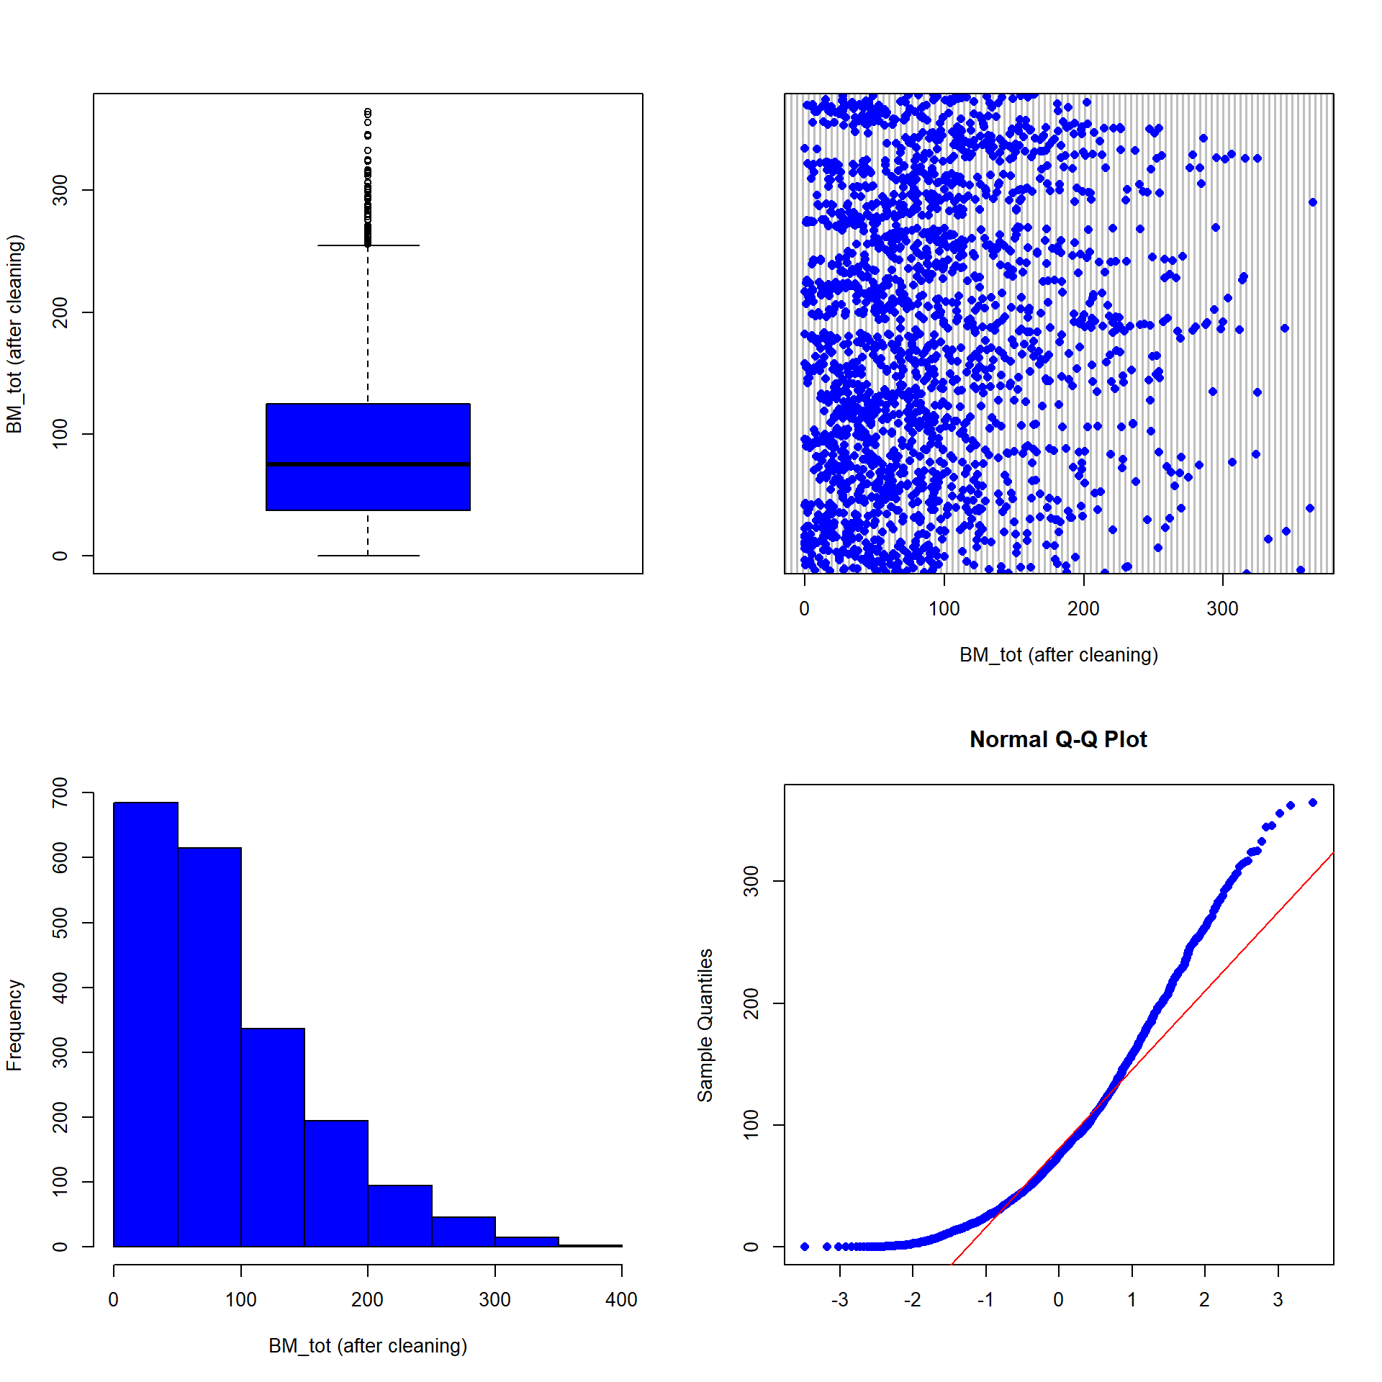

Materials and methods
3. Data cleaning
Total abundance (ind./m²) Total taxonomic richness
Total biomass (g/m²)

Slide 15

Materials and methods
4. Variable selection
Category | Abbr | Description
Land use | For | Forest (all types)
 | Gua | Green urban areas
 | Nag | Natural grasslands
 | Nial | Non-irrigated arable land
 | Pmo | Pastures, meadows and other permanent grasslands under agricultural use
 | Viny | Vineyards
Location | Long | Longitude
 | Lat | Latitude
Climate | bio12 | Annual precipitation amount
 | bio3 | Isothermality
Soil | Clay | Clay particles
 | Silt | Silt particles
 | CaCO3 | Calcium carbonates
 | P | Phosphorus
 | N | Nitrogen
Random Forrest model
Variable importance (Fourcade & Vercauteren, 2022; Zeiss et al., 2024)
Avoid overfitting (Vaughan et Ormerod, 2005)
Notes:
Parler aussi de la liimites de l’utilisation de RF pour la selection

Slide 16

Materials and methods
5. Data partitioning
Data partition (3 576 rows, 15 columns)
Train data (80 %)
Test data (20 %)
Notes:
Par la suite, nos avons tester l’homogeneité de la partition avec le test de Kolmogorov qui indique que les données sont similaire entre train et test

Slide 17
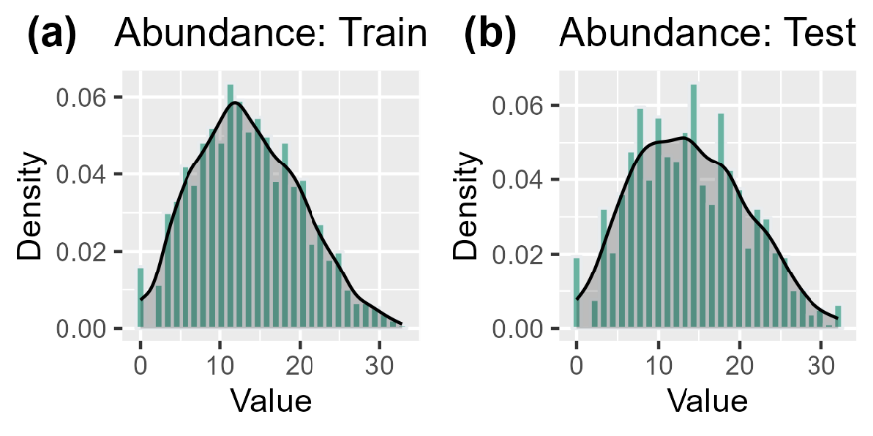
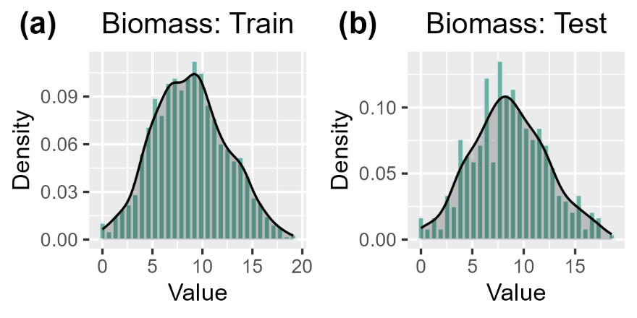
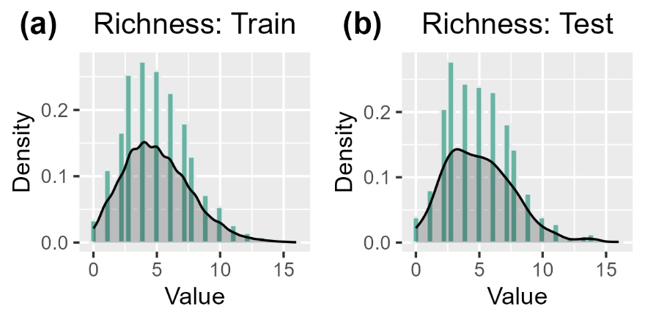
Materials and methods
5. Data partitioning
Data partition (3 576 rows, 15 columns)
Train data (80 %)
Test data (20 %)
Non-significant Kolmogorov-Smirnov test (p-value > 0.05) (Guisan et al., 2017)
Notes:
K cross validation, Test, Good balance 80:20, Distribution (resonse var and predictors),

Slide 18
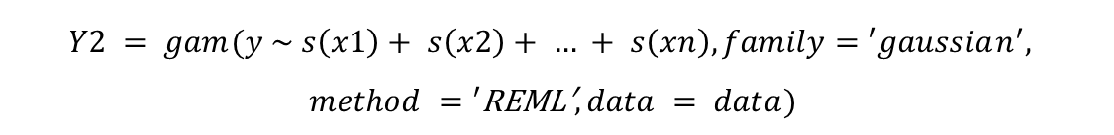
Materials and methods
6. Model fitting and calibration
Generalized Linear Models (GLM)
Traditional regression algorithms
$$Y1 =\text{glm}\text{(}\text{y} \text{\sim }\text{x}\text{1 + }\text{x}\text{2 + … + }\text{xn}\text{, }\text{family}\text{ = ′}\text{gaussian}\text{′, }\text{data}\text{ = }\text{data}\text{)}$$
Generalized Additive Models (GAM)
$$Y2 = gam(y \sim s\left(x1\right)+ s\left(x2\right)+ … + s\left(xn\right), family=′gaussian^{′},$$
$$method =′\text{REML}\text{′}, data = data)$$

Slide 19

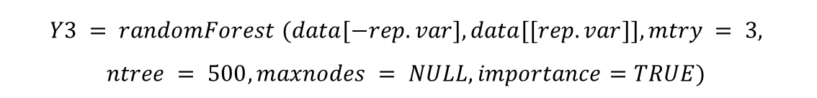
Materials and methods
6. Model fitting and calibration
RF default model
Machine learning algorithms
$$Y3 = randomForest (data[−rep.var],data[[rep.var]],$$
$$importance=TRUE)$$
RF final model: tuning by grid
$$Y3 = randomForest (data[−rep.var],data[[rep.var]],mtry = 3,$$
$$ntree = 500,maxnodes = NULL,importance=TRUE)$$
Random Forests (RF)

Slide 20
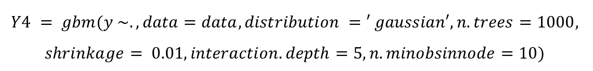
Materials and methods
6. Model fitting and calibration
GBM default model
Machine learning algorithms
$$Y4 = gbm(y \sim .,data=data,distribution =′ gaussian′)$$
GBM final model: tuning by grid
$$Y4 = gbm(y \sim ., data=data,distribution =′ gaussian′,n.trees=1000,$$
$$shrinkage= 0.01,interaction.depth=5,n.minobsinnode=10)$$
Generalized Boosted Models (GBM)

Slide 21
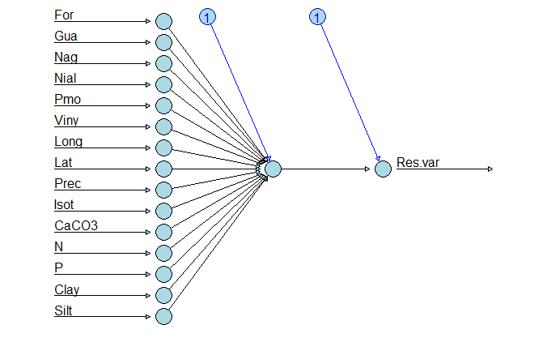
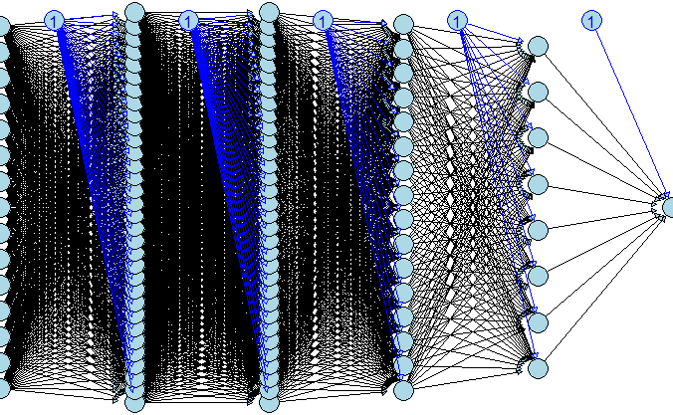
Materials and methods
6. Model fitting and calibration
ANN default model
Machine learning algorithms
ANN final model: tuning by grid
4 hidden layers with 32, 32, 16, and 8 neurons respectively
Artificial Neural Networks (ANN)
Notes:
input_shape = 15

Slide 22

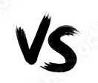
Materials and methods
7. Model evaluation & selection
R² (Coefficient of determination of a regression)
Observations
Predictions
RMSE (Root Mean Square Error)

Slide 23

Materials and methods
8. Prediction & mapping
Environmental data collection ➔ (CLC, Soil and Climate)
Prediction using the best model
800m

Slide 24

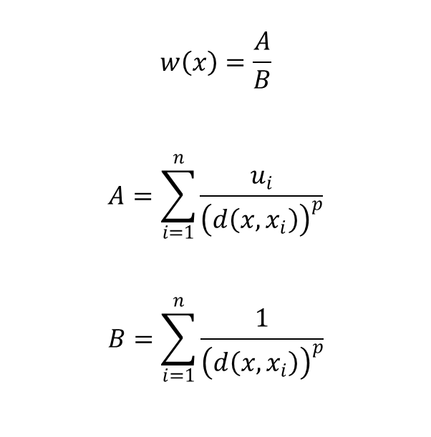
Materials and methods
8. Prediction & mapping
Environmental data collection ➔ (CLC, Soil and Climate)
Prediction using the best model
800m
Interpolation
Inverse Distance Weighting (IDW) (Hijmans et al., 2023; Pebesma & Graeler, 2023)
$$w\left(x\right)=\frac{A}{B}$$
$$A=\sum_{i=1}^{n}{\frac{u_{i}}{{\left(d\left(x,x_{i}\right)\right)}^{p}}}$$
$$B=\sum_{i=1}^{n}{\frac{1}{{\left(d\left(x,x_{i}\right)\right)}^{p}}}$$
w is the predicted value; x is the unknown point; n is the number of sampling points (n = 10); d is the distance; xi is the n-th know point; ui is the value of the know point; and p is the power coefficient (p = 10)
Notes:
Parler des cartes des variables de la base de donnée détailler dans letape 2

Slide 25
Results and discussions
Superiority of ensemble methods in predicting earthworm communities compared to traditional regression models
Algorithms | Response variables | R² | RMSE
GLM | Total abundance | 0.22 | 34.57
GAM |  | 0.26 | 33.06
RF |  | 0.43 | 25.20
GBM |  | 0.43 | 25.30
ANN |  | 0.35 | 28.94
GLM | Total biomass | 0.23 | 10.69
GAM |  | 0.24 | 10.50
RF |  | 0.35 | 8.76
GBM |  | 0.32 | 9.30
ANN |  | 0.27 | 10.50
GLM | Total taxonomic richness | 0.36 | 2.18
GAM |  | 0.44 | 2.04
RF |  | 0.59 | 1.75
GBM |  | 0.59 | 1.75
ANN |  | 0.40 | 2.16

Slide 26
Results and discussions
Superiority of ensemble methods in predicting earthworm communities compared to traditional regression models
Algorithms | Response variables | R² | RMSE
GLM | Total abundance | 0.22 | 34.57
GAM |  | 0.26 | 33.06
RF |  | 0.43 | 25.20
GBM |  | 0.43 | 25.30
ANN |  | 0.35 | 28.94
GLM | Total biomass | 0.23 | 10.69
GAM |  | 0.24 | 10.50
RF |  | 0.35 | 8.76
GBM |  | 0.32 | 9.30
ANN |  | 0.27 | 10.50
GLM | Total taxonomic richness | 0.36 | 2.18
GAM |  | 0.44 | 2.04
RF |  | 0.59 | 1.75
GBM |  | 0.59 | 1.75
ANN |  | 0.40 | 2.16
Ensemble methods (Breiman, 2001; Li & Wang, 2013)
Better captures nonlinear relationships Incorporates interactions between variables (Breiman, 2001)
Require large amounts of data (Yiu, 2021)
Poor interpretability

Slide 27
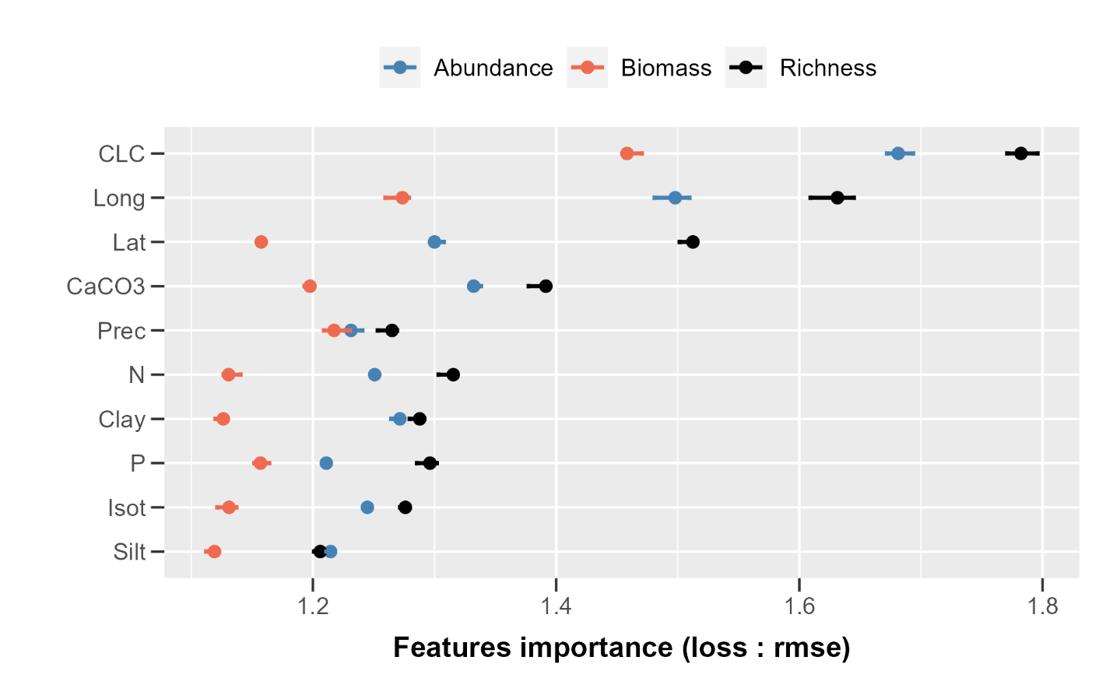
Results and discussions
Important effect of land use followed by soil location, climate and soil properties
Notes:
Perturbation anthropique

Slide 28

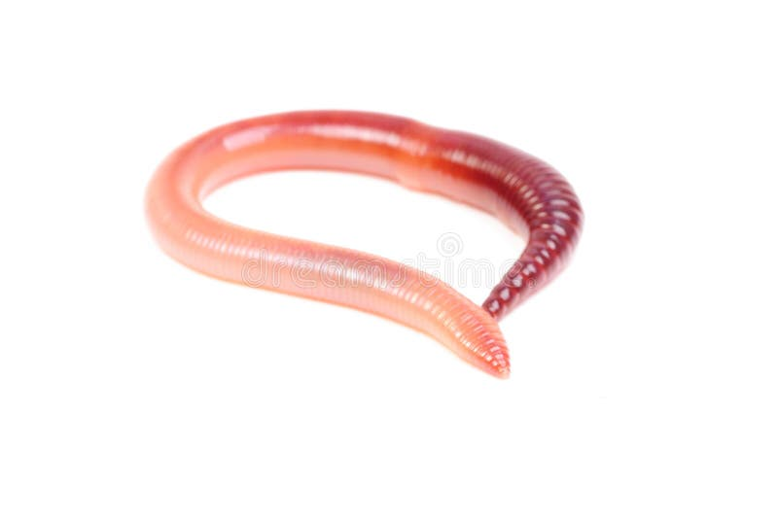

Results and discussions
Important effect of land use followed by soil location, climate and soil properties
Foods and habitats
(Iordache, 2010; Zhu and Zhu, 2015; Niswati et al., 2022)
Pastures
Natural grasslands
Green urban areas
Forests
Vineyards
Annual crops
Soil tillage, fertilization and pesticides (Pelosi et al., 2013, 2014; Maggi and Tang, 2021)
Notes:
Perturbation anthropique

Slide 29
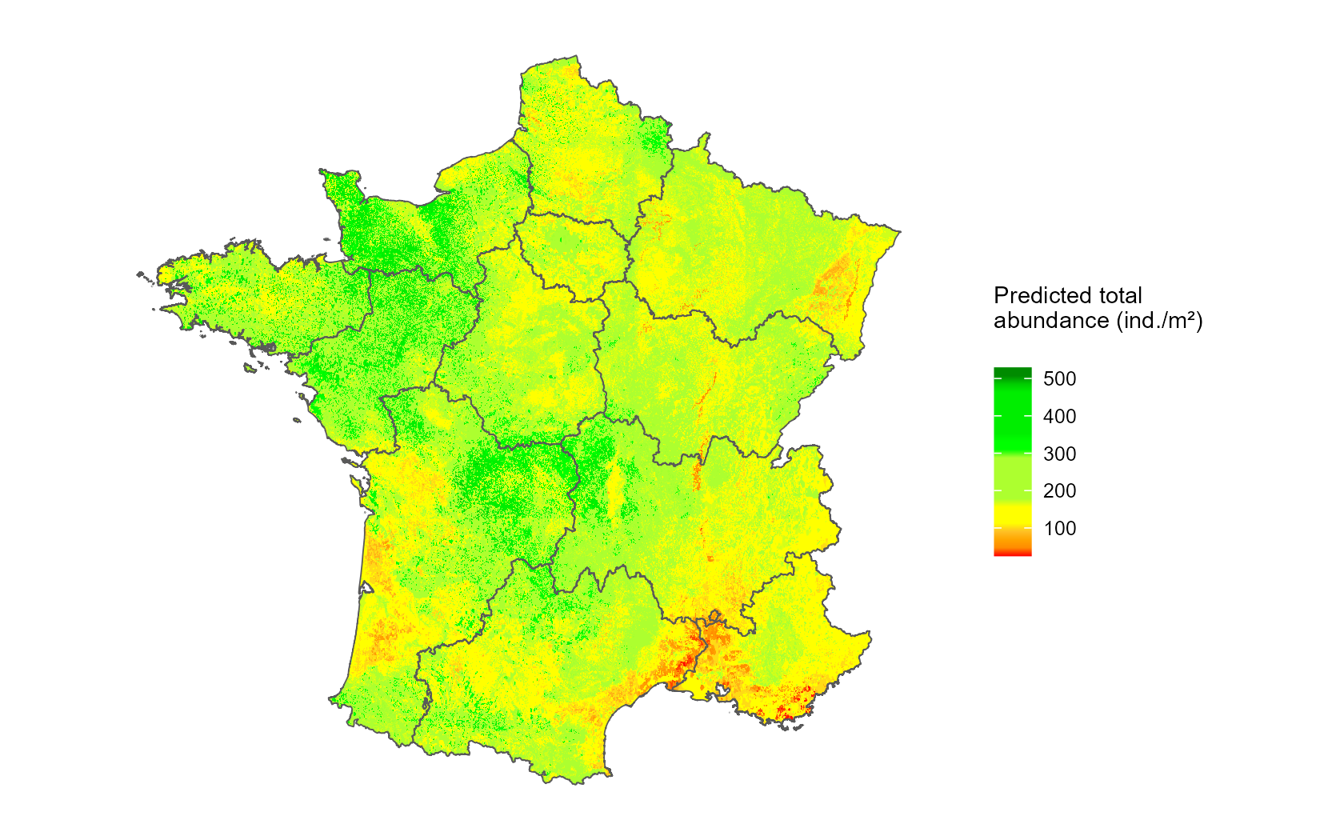
Results and discussions
Objective
Predicted spatial distribution of earthworm total abundance
Earthworm community was more abundant in the northwest and center of France
Land use
Climate
Soil

Slide 30



Conclusion
GLM GAM ANN GBM RF
Earthworm community prediction accuracy
Soil properties Climate Localisation Land use
Importance on earthworm community in France
Notes:
Parcequ’on comprendra mieux les fonctions ES

Slide 31
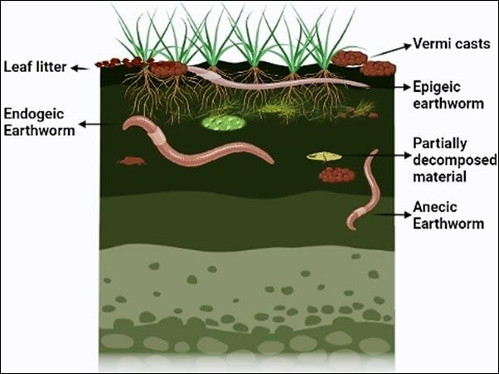
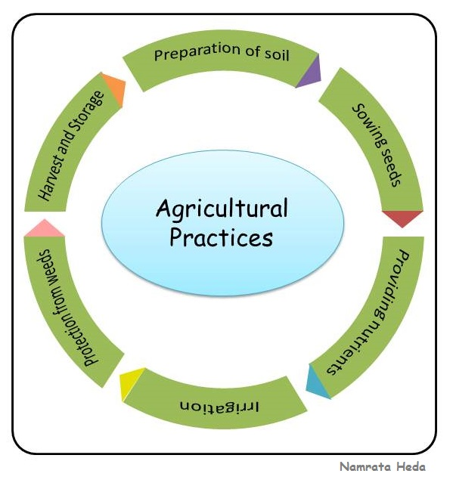
Conclusion
GLM GAM ANN GBM RF
Earthworm community prediction accuracy
Soil properties Climate Location Land use
Importance on earthworm community in France
Earthworm species Ecological categories Agricultural practices
Notes:
Parcequ’on comprendra mieux les fonctions ES

Slide 32
References
Apley, D.W., Zhu, J., 2019. Visualizing the Effects of Predictor Variables in Black Box Supervised Learning Models. https://doi.org/10.48550/arXiv.1612.08468
Ballabio, C., Lugato, E., Fernández-Ugalde, O., Orgiazzi, A., Jones, A., Borrelli, P., Montanarella, L., Panagos, P., 2019. Mapping LUCAS topsoil chemical properties at European scale using Gaussian process regression. Geoderma 355, 113912. https://doi.org/10.1016/j.geoderma.2019.113912
Bardgett, R.D., Van der Putten, W.H., 2014. Belowground biodiversity and ecosystem functioning. Nature 515, 505–511. https://doi.org/10.1038/nature13855
Bates, B., Kundzewicz, Z., Wu, S., 2008. Climate Change and Water. Intergovernmental Panel on Climate Change Secretariat.
Blouin, M., Hodson, M.E., Delgado, E.A., Baker, G., Brussaard, L., Butt, K.R., Dai, J., Dendooven, L., Peres, G., Tondoh, J.E., Cluzeau, D., Brun, J.-J., 2013. A review of earthworm impact on soil function and ecosystem services: Earthworm impact on ecosystem services. Eur. J. Soil Sci. 64, 161–182. https://doi.org/10.1111/ejss.12025
Breiman, L., 2001. Random Forests. Mach. Learn. 45, 5–32. https://doi.org/10.1023/A:1010933404324
Briones, M.J.I., Schmidt, O., 2017. Conventional tillage decreases the abundance and biomass of earthworms and alters their community structure in a global meta-analysis. Glob. Change Biol. 23, 4396–4419. https://doi.org/10.1111/gcb.13744
Capowiez, Y., Sammartino, S., Michel, E., 2014. Burrow systems of endogeic earthworms: Effects of earthworm abundance and consequences for soil water infiltration. Pedobiologia 57, 303–309. https://doi.org/10.1016/j.pedobi.2014.04.001
Cardinale, B.J., Duffy, J.E., Gonzalez, A., Hooper, D.U., Perrings, C., Venail, P., Narwani, A., Mace, G.M., Tilman, D., Wardle, D.A., Kinzig, A.P., Daily, G.C., Loreau, M., Grace, J.B., Larigauderie, A., Srivastava, D.S., Naeem, S., 2012. Biodiversity loss and its impact on humanity. Nature 486, 59–67. https://doi.org/10.1038/nature11148
Casalicchio, G., Molnar, C., Schratz, P., 2024. iml: Interpretable Machine Learning.
Cluzeau, D., Guernion, M., Chaussod, R., Martin-Laurent, F., Villenave, C., Cortet, J., Ruiz-Camacho, N., Pernin, C., Mateille, T., Philippot, L., Bellido, A., Rougé, L., Arrouays, D., Bispo, A., Pérès, G., 2012. Integration of biodiversity in soil quality monitoring: Baselines for microbial and soil fauna parameters for different land-use types. Eur. J. Soil Biol., Bioindication in Soil Ecosystems 49, 63–72. https://doi.org/10.1016/j.ejsobi.2011.11.003
Crittenden, S.J., Eswaramurthy, T., de Goede, R.G.M., Brussaard, L., Pulleman, M.M., 2014. Effect of tillage on earthworms over short- and medium-term in conventional and organic farming. Appl. Soil Ecol., XVI International Colloquium on Soil Zoology & XIII International Colloquium on Apterygota, Coimbra, 2012 – Selected papers 83, 140–148. https://doi.org/10.1016/j.apsoil.2014.03.001
Cunha, L., Brown, G.G., Stanton, D.W.G., Da Silva, E., Hansel, F.A., Jorge, G., McKey, D., Vidal-Torrado, P., Macedo, R.S., Velasquez, E., James, S.W., Lavelle, P., Kille, P., Network, the T.P. de I., 2016. Soil Animals and Pedogenesis: The Role of Earthworms in Anthropogenic Soils. Soil Sci. 181, 110–125. https://doi.org/10.1097/SS.0000000000000144
De Wandeler, H., Sousa-Silva, R., Ampoorter, E., Bruelheide, H., Carnol, M., Dawud, S.M., Dănilă, G., Finer, L., Hättenschwiler, S., Hermy, M., Jaroszewicz, B., Joly, F.-X., Müller, S., Pollastrini, M., Ratcliffe, S., Raulund-Rasmussen, K., Selvi, F., Valladares, F., Van Meerbeek, K., Verheyen, K., Vesterdal, L., Muys, B., 2016. Drivers of earthworm incidence and abundance across European forests. Soil Biol. Biochem. 99, 167–178. https://doi.org/10.1016/j.soilbio.2016.05.003
Diallo, A., Hoeffner, K., Guillocheau, S., Sorgniard, P., Cluzeau, D., 2023. Combined effects of annual crop agricultural practices on earthworm communities. Appl. Soil Ecol. 192, 105073. https://doi.org/10.1016/j.apsoil.2023.105073
Edwards, C.A., Arancon, N.Q., 2022. Biology and Ecology of Earthworms. Springer US, New York, NY. https://doi.org/10.1007/978-0-387-74943-3
Elith, J., Graham, C.H., 2009. Do they? How do they? WHY do they differ? On finding reasons for differing performances of species distribution models. Ecography 32, 66–77. https://doi.org/10.1111/j.1600-0587.2008.05505.x
Elith, J., H. Graham*, C., P. Anderson, R., Dudík, M., Ferrier, S., Guisan, A., J. Hijmans, R., Huettmann, F., R. Leathwick, J., Lehmann, A., Li, J., G. Lohmann, L., A. Loiselle, B., Manion, G., Moritz, C., Nakamura, M., Nakazawa, Y., McC. M. Overton, J., Townsend Peterson, A., J. Phillips, S., Richardson, K., Scachetti-Pereira, R., E. Schapire, R., Soberón, J., Williams, S., S. Wisz, M., E. Zimmermann, N., 2006. Novel methods improve prediction of species’ distributions from occurrence data. Ecography 29, 129–151. https://doi.org/10.1111/j.2006.0906-7590.04596.x
Elith, J., Leathwick, J.R., 2009. Species Distribution Models: Ecological Explanation and Prediction Across Space and Time. Annu. Rev. Ecol. Evol. Syst. 40, 677–697. https://doi.org/10.1146/annurev.ecolsys.110308.120159
Ernst, G., Emmerling, C., 2009. Impact of five different tillage systems on soil organic carbon content and the density, biomass, and community composition of earthworms after a ten year period. Eur. J. Soil Biol. 45, 247–251. https://doi.org/10.1016/j.ejsobi.2009.02.002
FAO, I., 2020. State of knowledge of soil biodiversity – Status, challenges and potentialities. Summary for policy makers.
Fourcade, Y., Vercauteren, M., 2022. Predicted changes in the functional structure of earthworm assemblages in France driven by climate change. Divers. Distrib. 28, 1050–1066. https://doi.org/10.1111/ddi.13505a

Slide 33
References
Gabriac, Q., Ganault, P., Barois, I., Aranda-Delgado, E., Cimetière, E., Cortet, J., Gautier, M., Hedde, M., Marchán, D.F., Reyes, J.C.P., Stokes, A., Decaëns, T., 2022. Environmental drivers of earthworm communities along an altitudinal gradient in the French Alps. https://doi.org/10.1101/2022.10.13.512055
Greg, R., Edwards, D., Kriegler, B., Schroedl, S., Southworth, H., Greenwell, B., Boehmke, B., Cunningham, J., Developers (https://github.com/gbm-developers), G.B.M., 2024. gbm: Generalized Boosted Regression Models.
Guisan, A., Thuiller, W., Zimmermann, N.E., 2017. Habitat Suitability and Distribution Models: With Applications in R, Ecology, Biodiversity and Conservation. Cambridge University Press, Cambridge. https://doi.org/10.1017/9781139028271
Hijmans, R.J., Elith, J., 2019. Spatial Distribution Models.
Hoeffner, K., Hotte, H., Cluzeau, D., Charrier, X., Gastal, F., Pérès, G., 2021. Effects of temporary grassland introduction into annual crop rotations and nitrogen fertilisation on earthworm communities and forage production. Appl. Soil Ecol. 162, 103893. https://doi.org/10.1016/j.apsoil.2021.103893
Hooper, D.U., Adair, E.C., Cardinale, B.J., Byrnes, J.E.K., Hungate, B.A., Matulich, K.L., Gonzalez, A., Duffy, J.E., Gamfeldt, L., O’Connor, M.I., 2012. A global synthesis reveals biodiversity loss as a major driver of ecosystem change. Nature 486, 105–108. https://doi.org/10.1038/nature11118
Horrigue, W., Dequiedt, S., Chemidlin Prévost-Bouré, N., Jolivet, C., Saby, N.P.A., Arrouays, D., Bispo, A., Maron, P.-A., Ranjard, L., 2016. Predictive model of soil molecular microbial biomass. Ecol. Indic. 64, 203–211. https://doi.org/10.1016/j.ecolind.2015.12.004
Iordache, M., 2010. Abundance of earthworms under fertilization with organo-mineral fertilizers in a chernozem from west of Romania. J. Food Agric. Environ. 10, 1103–1105.
Joly, D., Brossard, T., Cardot, H., Cavailhes, J., Hilal, M., Wavresky, P., 2010. Les types de climats en France, une construction spatiale. Cybergeo. https://doi.org/10.4000/cybergeo.23155
Jones, C.G., Lawton, J.H., Shachak, M., 1994. Organisms as Ecosystem Engineers, in: Samson, F.B., Knopf, F.L. (Eds.), Ecosystem Management: Selected Readings. Springer, New York, NY, pp. 130–147. https://doi.org/10.1007/978-1-4612-4018-1_14
Kalinowski, T., Falbel, D., Allaire, J.J., Chollet, F., RStudio, Google, Tang [ctb, Y., cph, Bijl, W.V.D., Studer, M., Keydana, S., 2024a. keras: R Interface to “Keras.”
Kalinowski, T., Falbel, D., Allaire, J.J., RStudio, https://d3js.org/), M.B. (D3 library-, http://c3js.org/), M.T. (C3 library-, library), jQuery F. (jQuery, inst/views/components/jquery-AUTHORS.txt), jQuery contributors (jQuery library; authors:, plugin), S.B. (jQuery visibilityChanged, https://materializecss.com/), M. (Materizlize library-, https://vuejs.org/), Y.Y. (Vue js library-, https://github.com/kpdecker/jsdiff/), K.D. (jsdiff library-, https://diff2html.xyz/), R.F. (diff2html library-, https://highlightjs.org/), I.S. (highlight js library-, library), Y.P. (highlightjs-line-numbers, 2024b. tfruns: Training Run Tools for “TensorFlow.”
Karger, D.N., Conrad, O., Böhner, J., Kawohl, T., Kreft, H., Soria-Auza, R.W., Zimmermann, N.E., Linder, H.P., Kessler, M., 2017. Climatologies at high resolution for the earth’s land surface areas. Sci. Data 4, 170122. https://doi.org/10.1038/sdata.2017.122
Lavelle, P., Bignell, D., Lepage, M., Wolters, V., Roger, P., Ineson, P., Heal, O.W., Dhillion, S., 1997. Soil function in a changing world: the role of invertebrate ecosystem engineers. Eur. J. Soil Biol.
Leroy, B.L.M., Schmidt, O., Van den Bossche, A., Reheul, D., Moens, M., 2008. Earthworm population dynamics as influenced by the quality of exogenous organic matter. Pedobiologia 52, 139–150. https://doi.org/10.1016/j.pedobi.2008.07.001
Li, X., Wang, Y., 2013. Applying various algorithms for species distribution modelling. Integr. Zool. 8, 124–135. https://doi.org/10.1111/1749-4877.12000
Maggi, F., Tang, F.H.M., 2021. Estimated decline in global earthworm population size caused by pesticide residue in soil. Soil Secur. 5, 100014. https://doi.org/10.1016/j.soisec.2021.100014
Marchán, D.F., Csuzdi, C., Decaëns, T., Szederjesi, T., Pizl, V., Domínguez, J., 2021. The disjunct distribution of relict earthworm genera clarifies the early historical biogeography of the Lumbricidae (Crassiclitellata, Annelida). J. Zool. Syst. Evol. Res. 59, 1703–1717. https://doi.org/10.1111/jzs.12514
Marchán, D.F., Domínguez, J., 2022. Evaluating the Conservation Status of a North-Western Iberian Earthworm (Compostelandrilus cyaneus) with Insight into Its Genetic Diversity and Ecological Preferences. Genes 13, 337. https://doi.org/10.3390/genes13020337
Marchán, D.F., Refoyo, P., Fernández, R., Novo, M., de Sosa, I., Díaz Cosín, D.J., 2016. Macroecological inferences on soil fauna through comparative niche modeling: The case of Hormogastridae (Annelida, Oligochaeta). Eur. J. Soil Biol. 75, 115–122. https://doi.org/10.1016/j.ejsobi.2016.05.003
Marchán, D.F., Refoyo, P., Novo, M., Fernández, R., Trigo, D., Díaz Cosín, D.J., 2015. Predicting soil micro-variables and the distribution of an endogeic earthworm species through a model based on large-scale variables. Soil Biol. Biochem. 81, 124–127. https://doi.org/10.1016/j.soilbio.2014.10.023
Mi, C., Huettmann, F., Guo, Y., Han, X., Wen, L., 2017. Why choose Random Forest to predict rare species distribution with few samples in large undersampled areas? Three Asian crane species models provide supporting evidence. PeerJ 5, e2849. https://doi.org/10.7717/peerj.2849

Slide 34
References
Nearing, M.A., Pruski, F.F., O’Neal, M.R., 2004. Expected climate change impacts on soil erosion rates: A review. J. Soil Water Conserv. 59, 43–50.
Niswati, A., Liyana, Prasetyo, D., Lumbanraja, J., 2022. Abundance and biomass of earthworm as affected by long-term different types of soil tillage and fertilization on mung bean plantation at Ultisols. IOP Conf. Ser. Earth Environ. Sci. 1018, 012012. https://doi.org/10.1088/1755-1315/1018/1/012012
Oppel, S., Meirinho, A., Ramírez, I., Gardner, B., O’Connell, A.F., Miller, P.I., Louzao, M., 2012. Comparison of five modelling techniques to predict the spatial distribution and abundance of seabirds. Biol. Conserv., Seabirds and Marine Protected Areas planning 156, 94–104. https://doi.org/10.1016/j.biocon.2011.11.013
Palm, J., van Schaik, N.L.M.B., Schröder, B., 2013. Modelling distribution patterns of anecic, epigeic and endogeic earthworms at catchment-scale in agro-ecosystems. Pedobiologia 56, 23–31. https://doi.org/10.1016/j.pedobi.2012.08.007
Pebesma, E., Graeler, B., 2023. gstat: Spatial and Spatio-Temporal Geostatistical Modelling, Prediction and Simulation.
Pelosi, C., Pey, B., Hedde, M., Caro, G., Capowiez, Y., Guernion, M., Peigné, J., Piron, D., Bertrand, M., Cluzeau, D., 2014. Reducing tillage in cultivated fields increases earthworm functional diversity. Appl. Soil Ecol., XVI International Colloquium on Soil Zoology & XIII International Colloquium on Apterygota, Coimbra, 2012 – Selected papers 83, 79–87. https://doi.org/10.1016/j.apsoil.2013.10.005
Pelosi, Toutous, L., Chiron, F., Dubs, F., Hedde, M., Muratet, A., Ponge, J.-F., Salmon, S., Makowski, D., 2013. Reduction of pesticide use can increase earthworm populations in wheat crops in a European temperate region. Agric. Ecosyst. Environ. 181, 223–230. https://doi.org/10.1016/j.agee.2013.10.003
Perreault, J.M., Whalen, J.K., 2006. Earthworm burrowing in laboratory microcosms as influenced by soil temperature and moisture. Pedobiologia 50, 397–403. https://doi.org/10.1016/j.pedobi.2006.07.003
Peterson, R.A., 2023. bestNormalize: Normalizing Transformation Functions.
Phillips, H.R.P., Guerra, C.A., Bartz, M.L.C., Briones, M.J.I., Brown, G., Crowther, T.W., Ferlian, O., Gongalsky, K.B., van den Hoogen, J., Krebs, J., Orgiazzi, A., Routh, D., Schwarz, B., Bach, E.M., Bennett, J.M., Brose, U., Decaëns, T., König-Ries, B., Loreau, M., Mathieu, J., Mulder, C., van der Putten, W.H., Ramirez, K.S., Rillig, M.C., Russell, D., Rutgers, M., Thakur, M.P., de Vries, F.T., Wall, D.H., Wardle, D.A., Arai, M., Ayuke, F.O., Baker, G.H., Beauséjour, R., Bedano, J.C., Birkhofer, K., Blanchart, E., Blossey, B., Bolger, T., Bradley, R.L., Callaham, M.A., Capowiez, Y., Caulfield, M.E., Choi, A., Crotty, F.V., Crumsey, J.M., Dávalos, A., Diaz Cosin, D.J., Dominguez, A., Duhour, A.E., van Eekeren, N., Emmerling, C., Falco, L.B., Fernández, R., Fonte, S.J., Fragoso, C., Franco, A.L.C., Fugère, M., Fusilero, A.T., Gholami, S., Gundale, M.J., López, M.G., Hackenberger, D.K., Hernández, L.M., Hishi, T., Holdsworth, A.R., Holmstrup, M., Hopfensperger, K.N., Lwanga, E.H., Huhta, V., Hurisso, T.T., Iannone, B.V., Iordache, M., Joschko, M., Kaneko, N., Kanianska, R., Keith, A.M., Kelly, C.A., Kernecker, M.L., Klaminder, J., Koné, A.W., Kooch, Y., Kukkonen, S.T., Lalthanzara, H., Lammel, D.R., Lebedev, I.M., Li, Y., Jesus Lidon, J.B., Lincoln, N.K., Loss, S.R., Marichal, R., Matula, R., Moos, J.H., Moreno, G., Morón-Ríos, A., Muys, B., Neirynck, J., Norgrove, L., Novo, M., Nuutinen, V., Nuzzo, V., Mujeeb Rahman P, Pansu, J., Paudel, S., Pérès, G., Pérez-Camacho, L., Piñeiro, R., Ponge, J.-F., Rashid, M.I., Rebollo, S., Rodeiro-Iglesias, J., Rodríguez, M.Á., Roth, A.M., Rousseau, G.X., Rozen, A., Sayad, E., van Schaik, L., Scharenbroch, B.C., Schirrmann, M., Schmidt, O., Schröder, B., Seeber, J., Shashkov, M.P., Singh, J., Smith, S.M., Steinwandter, M., Talavera, J.A., Trigo, D., Tsukamoto, J., de Valença, A.W., Vanek, S.J., Virto, I., Wackett, A.A., Warren, M.W., Wehr, N.H., Whalen, J.K., Wironen, M.B., Wolters, V., Zenkova, I.V., Zhang, W., Cameron, E.K., Eisenhauer, N., 2019. Global distribution of earthworm diversity. Science 366, 480–485. https://doi.org/10.1126/science.aax4851
Postma-Blaauw, M.B., Bloem, J., Faber, J.H., van Groenigen, J.W., de Goede, R.G.M., Brussaard, L., 2006. Earthworm species composition affects the soil bacterial community and net nitrogen mineralization. Pedobiologia 50, 243–256. https://doi.org/10.1016/j.pedobi.2006.02.001
R Core Team, 2023. A language and environment for statistical computing.
Roman Dobarco, M., Bourennane, H., Arrouays, D., Saby, N., Cousin, I., Manuel, M.P., 2022. Propriétés de granulométrie (argile, limons, sables) et d’éléments grossiers pour la France métropolitaine au pas de 90 m. https://doi.org/10.57745/N4E4NE
Rutgers, M., Orgiazzi, A., Gardi, C., Römbke, J., Jänsch, S., Keith, A.M., Neilson, R., Boag, B., Schmidt, O., Murchie, A.K., Blackshaw, R.P., Pérès, G., Cluzeau, D., Guernion, M., Briones, M.J.I., Rodeiro, J., Piñeiro, R., Cosín, D.J.D., Sousa, J.P., Suhadolc, M., Kos, I., Krogh, P.-H., Faber, J.H., Mulder, C., Bogte, J.J., Wijnen, H.J. van, Schouten, A.J., Zwart, D. de, 2016. Mapping earthworm communities in Europe. Appl. Soil Ecol., Soil biodiversity and ecosystem functions across Europe: A transect covering variations in bio-geographical zones, land use and soil properties 97, 98–111. https://doi.org/10.1016/j.apsoil.2015.08.015
Salako, G., Russell, D.J., Stucke, A., Eberhardt, E., 2023. Assessment of multiple model algorithms to predict earthworm geographic distribution range and biodiversity in Germany: implications for soil-monitoring and species-conservation needs. Biodivers. Conserv. 32, 2365–2394. https://doi.org/10.1007/s10531-023-02608-9
Sharma, D.K., Tomar, S., Chakraborty, D., 2017. Role of earthworm in improving soil structure and functioning. Curr. Sci. 113, 1064–1071.
Singh, J., Schädler, M., Demetrio, W., Brown, G.G., Eisenhauer, N., 2019. Climate change effects on earthworms - a review. Soil Org. 91, 114–138. https://doi.org/10.25674/so91iss3pp114
Smith, R.G., McSwiney, C.P., Grandy, A.S., Suwanwaree, P., Snider, R.M., Robertson, G.P., 2008. Diversity and abundance of earthworms across an agricultural land-use intensity gradient. Soil Tillage Res. 100, 83–88. https://doi.org/10.1016/j.still.2008.04.009
Spurgeon, D.J., Keith, A.M., Schmidt, O., Lammertsma, D.R., Faber, J.H., 2013. Land-use and land-management change: relationships with earthworm and fungi communities and soil structural properties. BMC Ecol. 13, 46. https://doi.org/10.1186/1472-6785-13-46

Slide 35
References
Thakur, M.P., Reich, P.B., Hobbie, S.E., Stefanski, A., Rich, R., Rice, K.E., Eddy, W.C., Eisenhauer, N., 2018. Reduced feeding activity of soil detritivores under warmer and drier conditions. Nat. Clim. Change 8, 75–78. https://doi.org/10.1038/s41558-017-0032-6
Valavi, R., Elith, J., Lahoz-Monfort, J.J., Guillera-Arroita, G., 2021. Modelling species presence-only data with random forests. Ecography 44, 1731–1742. https://doi.org/10.1111/ecog.05615
van der Wal, A., Geerts, R.H.E.M., Korevaar, H., Schouten, A.J., op Akkerhuis, G.A.J.M.J., Rutgers, M., Mulder, C., 2009. Dissimilar response of plant and soil biota communities to long-term nutrient addition in grasslands. Biol. Fertil. Soils 45, 663–667. https://doi.org/10.1007/s00374-009-0371-1
Van Groenigen, J.W., Lubbers, I.M., Vos, H.M.J., Brown, G.G., De Deyn, G.B., van Groenigen, K.J., 2014. Earthworms increase plant production: a meta-analysis. Sci. Rep. 4, 6365. https://doi.org/10.1038/srep06365
Van Groenigen, J.W., Van Groenigen, K.J., Koopmans, G.F., Stokkermans, L., Vos, H.M.J., Lubbers, I.M., 2019. How fertile are earthworm casts? A meta-analysis. Geoderma 338, 525–535. https://doi.org/10.1016/j.geoderma.2018.11.001
Vaughan, I.P., Ormerod, S.J., 2005. The continuing challenges of testing species distribution models. J. Appl. Ecol. 42, 720–730. https://doi.org/10.1111/j.1365-2664.2005.01052.x
Wood, S., 2023. mgcv: Mixed GAM Computation Vehicle with Automatic Smoothness Estimation.
Yiu, T., 2021. Understanding Random Forest [WWW Document]. Medium. URL https://towardsdatascience.com/understanding-random-forest-58381e0602d2 (accessed 1.18.24).
Zeiss, R., Briones, M.J.I., Mathieu, J., Lomba, A., Dahlke, J., Heptner, L.-F., Salako, G., Eisenhauer, N., Guerra, C.A., 2024. Effects of climate on the distribution and conservation of commonly observed European earthworms. Conserv. Biol. 38, e14187. https://doi.org/10.1111/cobi.14187
Zhu, X., Zhu, B., 2015. Diversity and abundance of soil fauna as influenced by long-term fertilization in cropland of purple soil, China. Soil Tillage Res., Soil Structure and its Functions in Ecosystems: Phase matter & Scale matter 146, 39–46. https://doi.org/10.1016/j.still.2014.07.004
Zurell, D., Franklin, J., König, C., Bouchet, P.J., Dormann, C.F., Elith, J., Fandos, G., Feng, X., Guillera-Arroita, G., Guisan, A., Lahoz-Monfort, J.J., Leitão, P.J., Park, D.S., Peterson, A.T., Rapacciuolo, G., Schmatz, D.R., Schröder, B., Serra-Diaz, J.M., Thuiller, W., Yates, K.L., Zimmermann, N.E., Merow, C., 2020. A standard protocol for reporting species distribution models. Ecography 43, 1261–1277. https://doi.org/10.1111/ecog.04960

Slide 36
Thank you for your attention

Slide 37

Acknowledgements
Thank my three internship supervisors, Mr. Daniel Cluzeau, Mr. Kevin Hoeffner, and Mr. Walid Horrigue, for your time mentoring me and for your invaluable advice and feedback.
Thank to all my colleagues in the EcoBioSol team at UMRS 6553 ECOBIO, Univ.Rennes – CNRS and the BIOCOM team at UMR 1347 Agroécologie (INRAE de Dijon) for their kindness and good spirits.

Slide 38
Additional information
All the material from my internship, including scripts, html files and datasets are available on my GitHub and my Rpubs account.

Slide 39





Tools

Slide 40
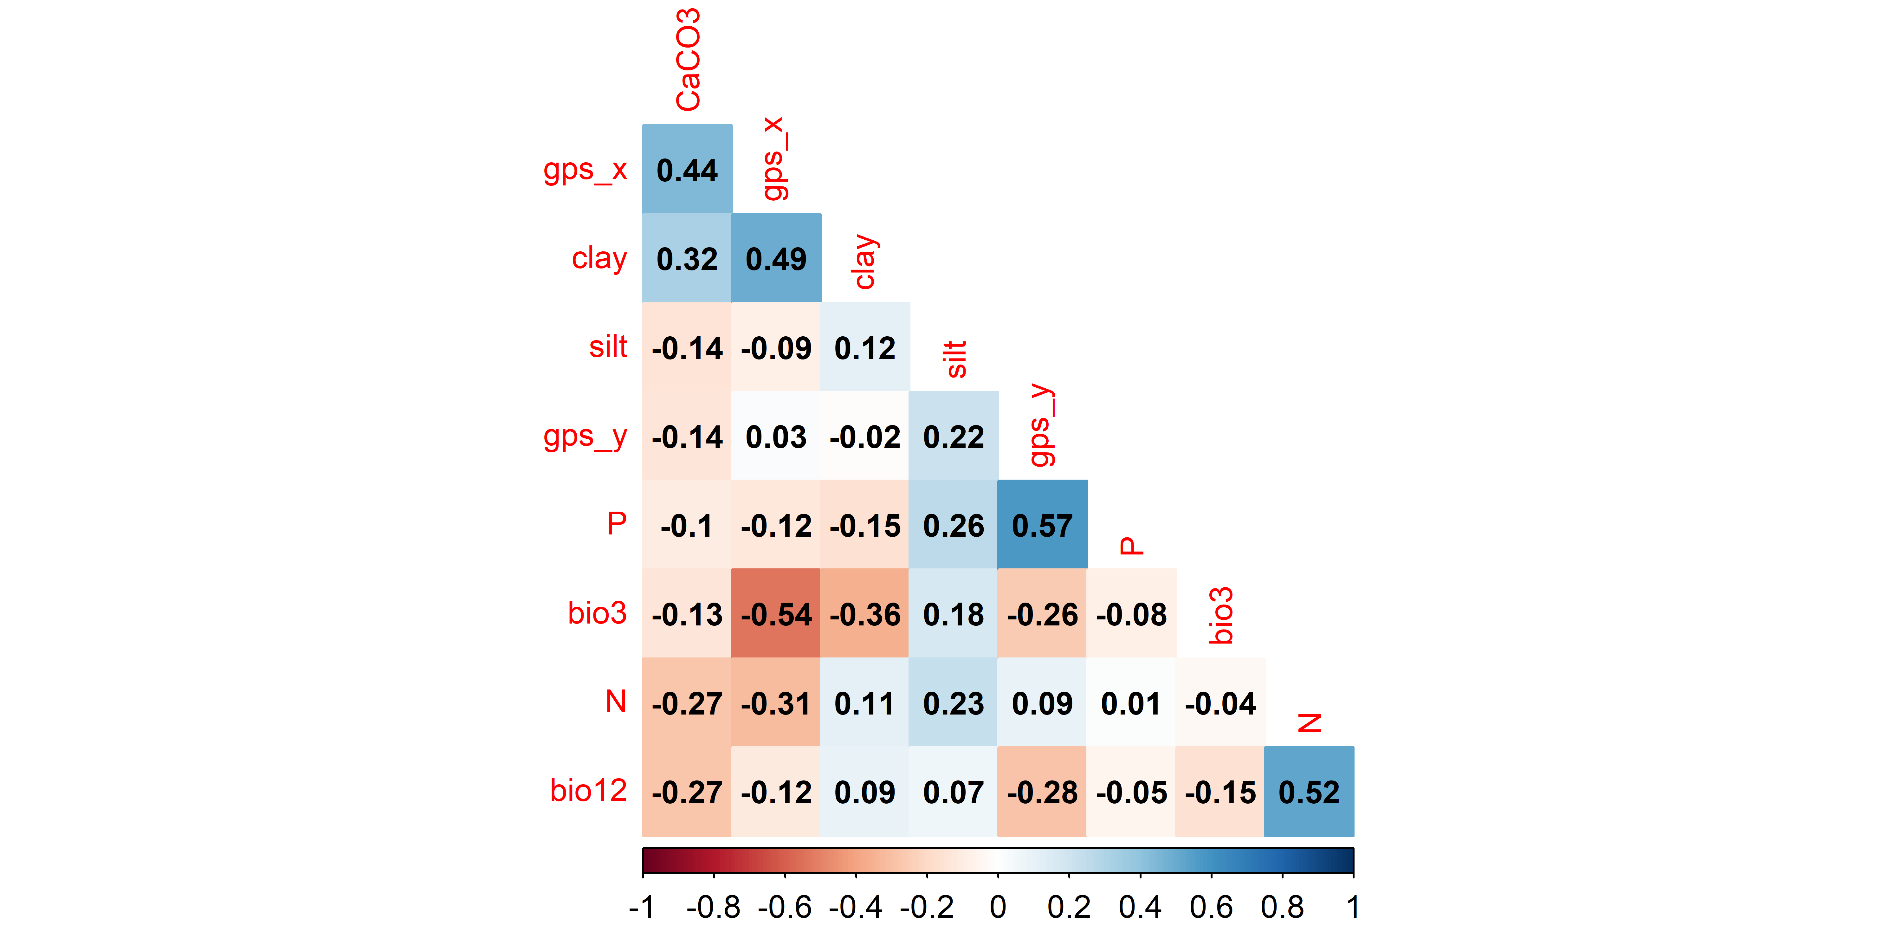

Slide 41
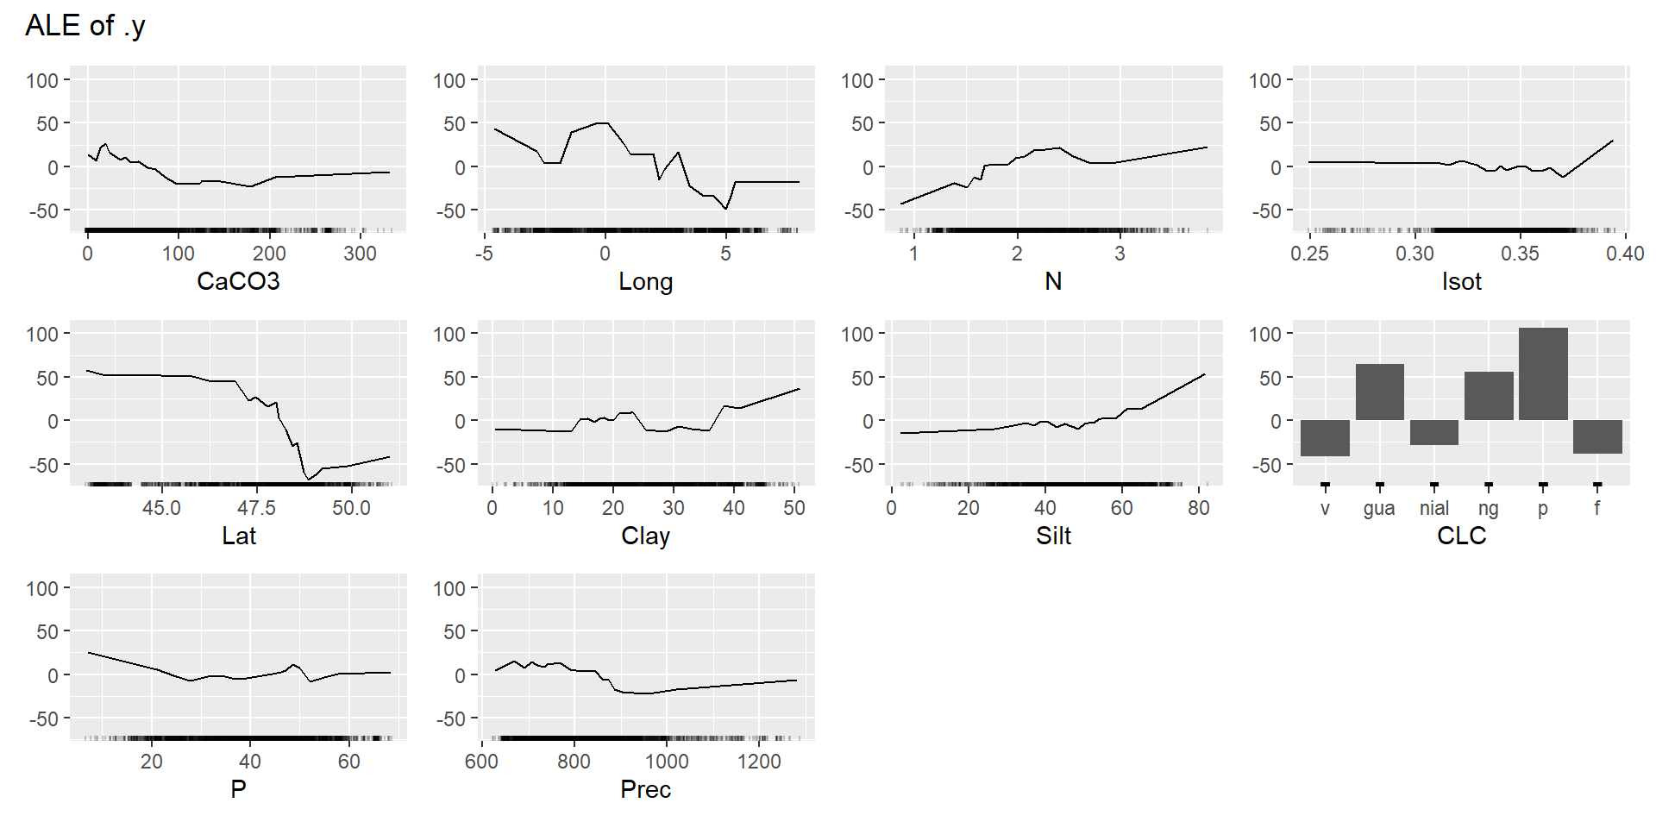
Notes:
Abundance

Slide 42
1. Biological data
2. Environmental data
3. Data cleaning
Modeling strategy
5. Data partitioning
4. Variable selection
80 % 20 %
ODMAP protocol
Zurell et al. (2020)
Training data Test data
6. Model calibration and fitting
7. Model evaluation and selection
8. Prediction, interpolation and mapping

Slide 43
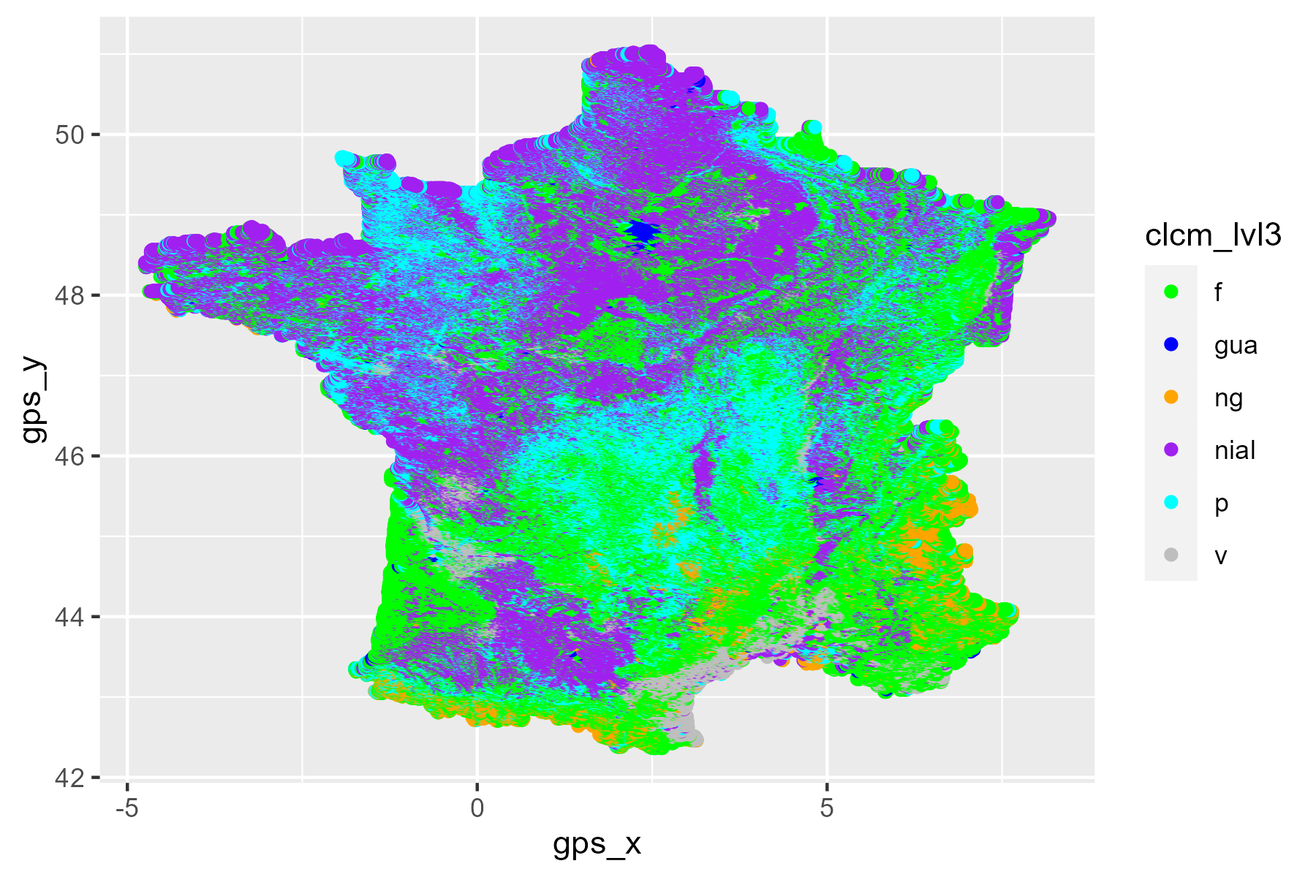

Slide 44
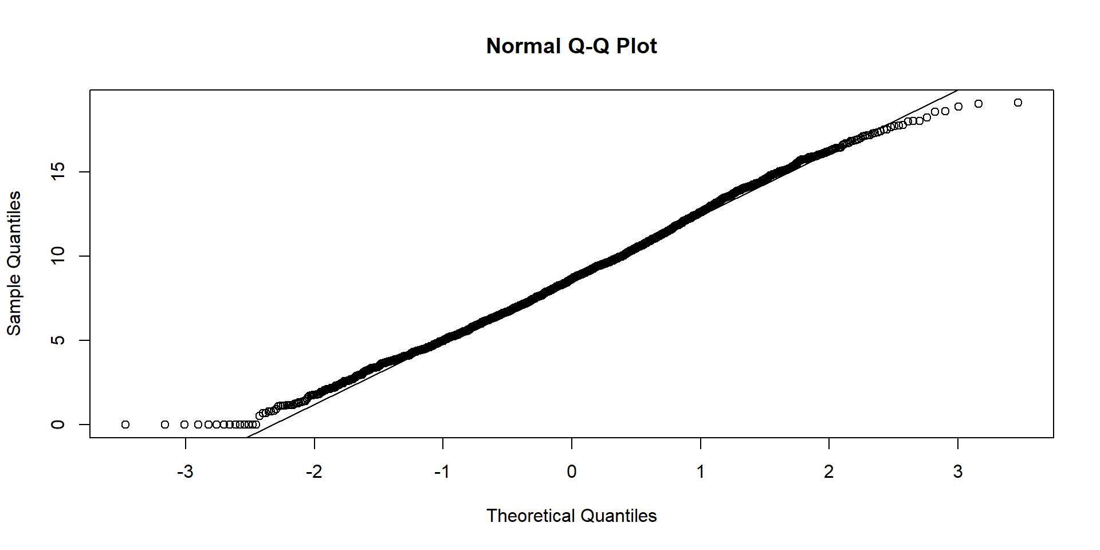
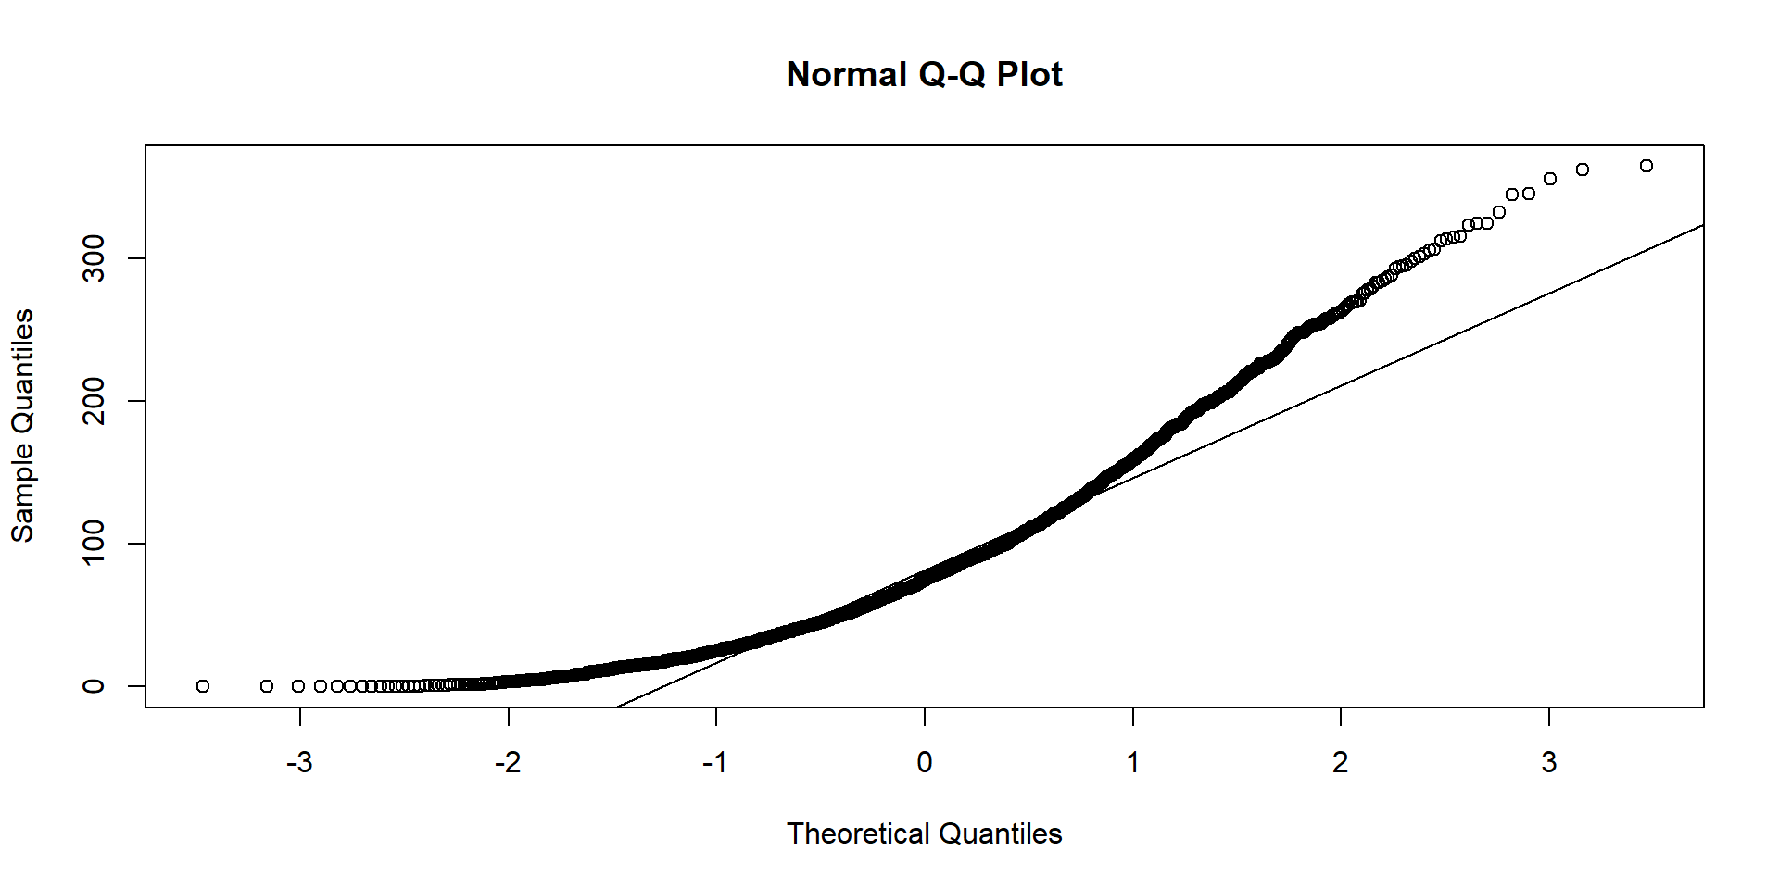
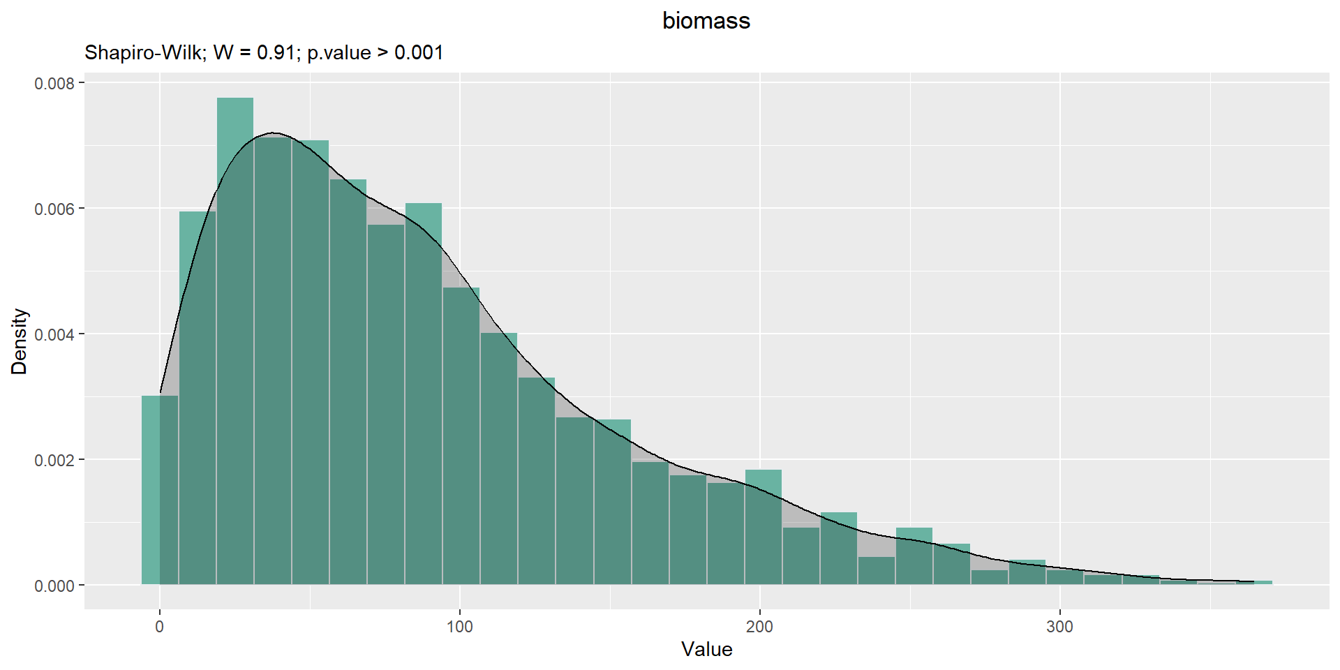
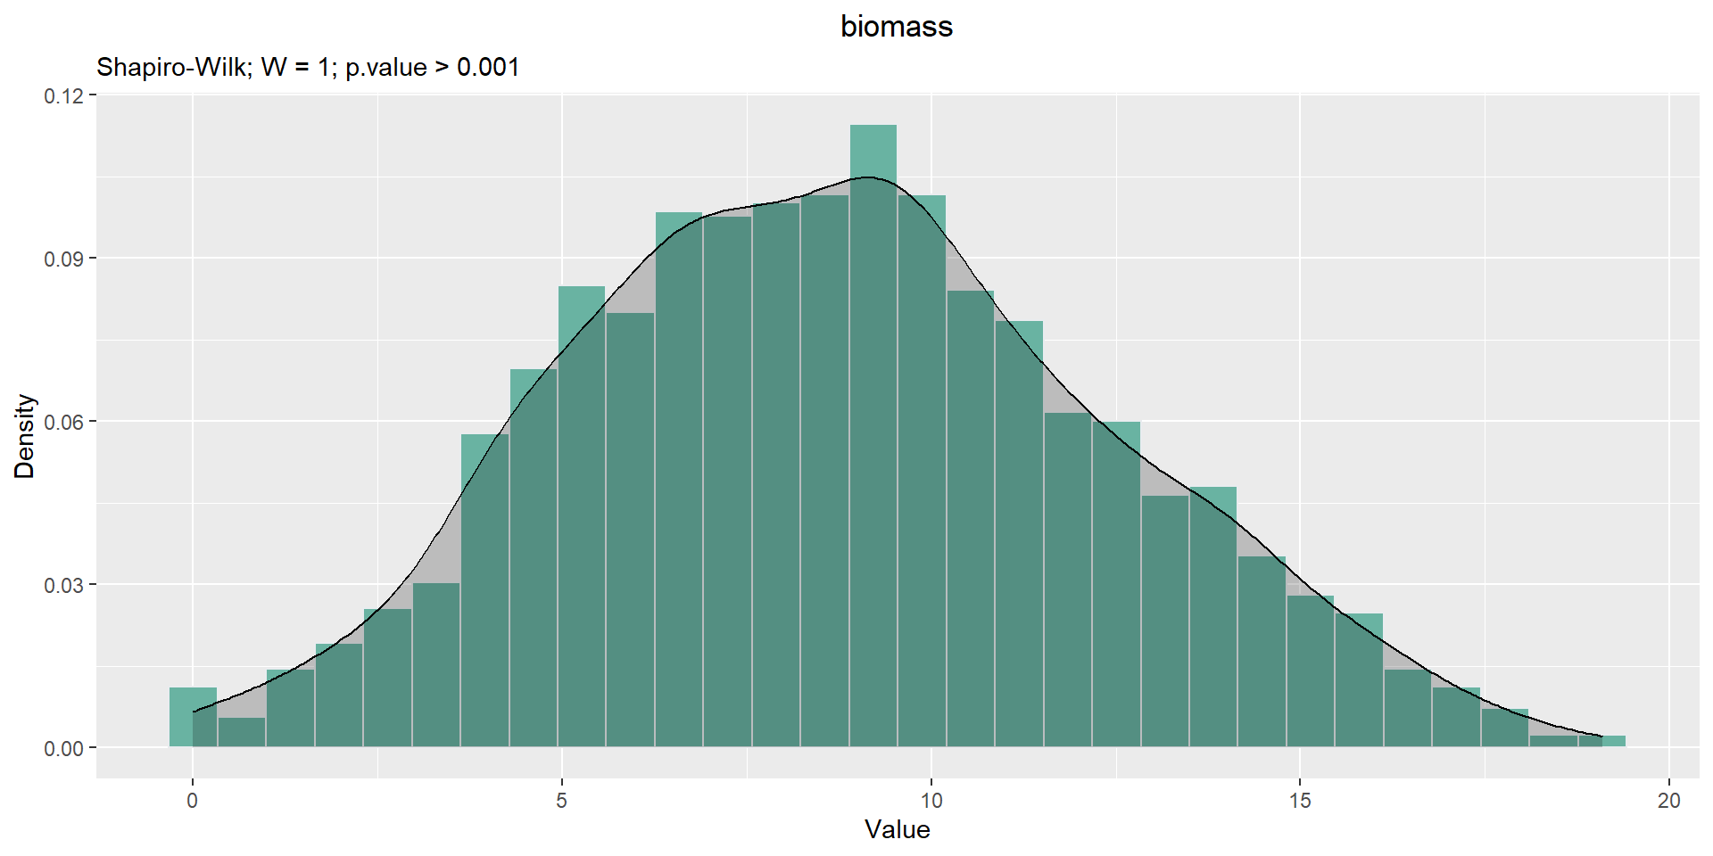
Materials and methods
3. Data cleaning
Numerical variables: Standardized transformation
Abundance and biomass: Square root transformation (test)
Total biomass (g/m²)

Slide 45

Materials and methods
2. Environmental data collection
Data harmonization
World Geodetic System (WGS84) coordinate system,
Resampled or disaggregated to a common resolution of 800 m

Slide 46
Materials and methods
3. Data cleaning
Removal of NAs and outliers (Grubbs' test, 0.05 threshold)
Categorical variables: Binary transformation
Numerical variables: Standardized transformation
Abundance and biomass: Square root transformation

Slide 47
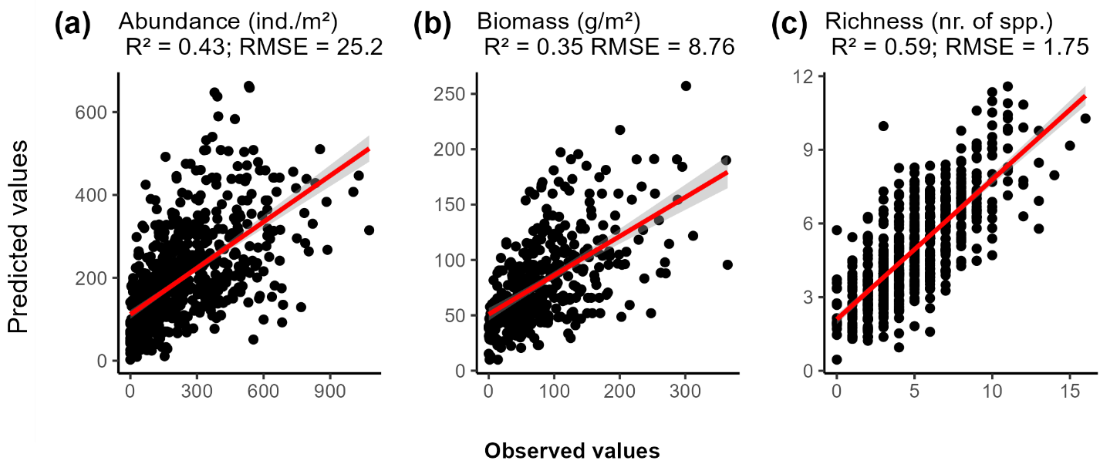
Results and discussions
Strong predictive performance of RF and GBM on earthworm parameters
RF RF GBM
Notes:
Less data on total biomass
Climate and soil variables come from external databases Six types of land use
Outliers

Slide 48

Results and discussions
Predicted spatial distribution of earthworm total biomass
Earthworm community was more abundant in the northwest and center of France
More grasslands plots were in the west, while forests and vineyards were more abundant in the east
Notes:
Peut être à suprimer

Slide 49

Results and discussions
Predicted spatial distribution of earthworm total taxonomic richness
Earthworm community was more abundant in the northwest and center of France
Eastward: continental climate with harsher summers and winters (Joly et al., 2010)
Notes:
more extreme than selected variables

Slide 50

Results and discussions
Predicted spatial distribution of earthworm diversity

Slide 51
Results and discussions
Important effect of land use followed by soil location, climate and soil properties
Spatial variables may obscure climatic variables
Positive effect of precipitation on earthworm communities (Rutgers et al., 2016; Salako et al., 2023; Zeiss et al., 2024)
Increased extreme precipitation can cause soil animal mortality, soil erosion, and habitat impairment (Bates et al., 2008; Thakur et al., 2018; Nearing et al., 2004; Singh et al., 2019)

Slide 52
Results and discussions
Important effect of land use followed by soil location, climate and soil properties
Clay-loam soils rich in nitrogen and low in CaCO₃ favor earthworms
High CaCO₃ levels are toxic to earthworms
Increased nitrogen boosts primary production (Iordache, 2010; Niswati et al., 2022)
Finer and denser textures are more easily ingested by geophages (Perreault and Whalen, 2006)

Slide 53


Materials and methods
6. Model fitting and calibration
Default model
Machine learning algorithms
$$Y3 = randomForest (data[−rep.var],data[[rep.var]],$$
$$importance=TRUE)$$
RF model tuning by grid
ntree = 100 to 2000 in increments of 200
mtry = 2 to 10 in increments of 1
maxnodes = NULL and 2 to 15 in increments of 1
Random Forests (RF)
$$Y3 = randomForest (data[−rep.var],data[[rep.var]],mtry = 3,$$
$$ntree = 500,maxnodes = NULL,importance=TRUE)$$

Slide 54

Materials and methods
6. Model fitting and calibration
Default model
Machine learning algorithms
$$Y4 = gbm(y \sim .,data=data,distribution =′ gaussian′)$$
GBM model tuning by grid
n.trees = 500 to 2000 in increments of 100
shrinkage = 0.01, 0.02, 0.05, 0.001, 0.002 and 0.005
interaction.depth = 1, 3, 5, 6, 8 and 10
n.minobsinnode = 2, 5, 10, 20, 30 and 50
Generalized Boosted Models (GBM)
$$Y4 = gbm(y \sim ., data=data,distribution =′ gaussian′,n.trees=1000,$$
$$shrinkage= 0.01,interaction.depth=5,n.minobsinnode=10)$$

Slide 55

Materials and methods
6. Model fitting and calibration
Machine learning algorithms
Tunning
runs = tuning_run(“Experiment.R”, flags = list(dense_units1 = c(64, 32), dense_units2 = c(16, 32), dense_units3 = c(8, 16), dense_units4 = c(4, 8),
dropout1 = c(0.4, 0.5), dropout2 = c(0.3, 0.4), dropout3 = c(0.2, 0.3), dropout4 = c(0.1, 0.2), batch_size = c(32, 64)))
Artificial Neural Networks (ANN)

Slide 56

Materials and methods
6. Model fitting and calibration
Default model
Sequential architecture
Activation function = ReLU
Optimizer = rmsprop
Tunning
Machine learning algorithms
Final model
Artificial Neural Networks (ANN)
➔ The final model consisted of 4 hidden layers with 32, 32, 16, and 8 neurons respectively
Notes:
input_shape = 15

Slide 57


Materials and methods
7. Model evaluation & selection
R² (Coefficient of determination of a regression)
Observations
Predictions
$$\text{RMSE}=\sqrt{\frac{1}{n}\sum_{i=1}^{n}{{\left(y_{i}−\hat{y_{i}}\right)}^{2}}}$$
(Root Mean Square Error)
n is the number of observations
$y_{i}$ represents the actual value of observation (i)
$\hat{y_{i}}$ represents the predicted value of observation (i)

Slide 58
Tasks | Problems | who is in charged | Decisions | Justifications
Check richness distribution | sites with species richness > 12 | Abdou, Sarah and Kevin | Under process
Co_kriging | IDW did not take acount the Land use | Abdou | Replace the IDW by Co-Krigine | More comprehensive, as it includes distance and land use
Maps | Interpolation | Abdou | Two maps (with and without interpolation)
Climate variable | Effets of the time scale | Abdou and Helene | Script to extract data for each year,10 years, 12 months and 3 months befor the sampling | Climate variable : 10 years; meterological conditions (12 and 3 months)
Model selection | Why not others models, like Bayesian ? | Abdou | Keep the five algorithms | These algorithms were chosen based on their classification as regression algorithms (GLM and GAM) and machine learning algorithms (RF, GBM, and ANN), as well as their widespread use in recent studies (Li & Wang, 2013; Rutgers et al., 2016; Valavi et al., 2021; Fourcade & Vercauteren, 2022; Salako et al., 2023)
GLM optimisation | Not optimizing enough | Abdou | Make the optimisation | To have the same approach as other algorithms
Land use: Forest | coniferous forest: Different from other types of forest | Abdou | Remove coniferous forest | Different from other types of forest
Land use: Forest | The Uban Forest is closer to the Forest than the Green urban areas | Kevin | Merge Urban forest with forest | Closer to the forest
Protocol selection | Maybe abundance/biomass/diversity is different between sampling protocols | Abdou and ? | No change
Soil variables | pH or CaCo3 ?
Model averaging | For GLM and GAM ; agregation of models to provide a final model (from the different models, give a weight to each model) | Abdou
Variable selection | based on - expert opinion - stats (RF ou ACP ou corrélation) - mix ? what about causality (DAG) | Abdou | Three approche
Soil variables database | LUCAS presents limits (nb points) → interest of other DB : BDAT/ RMQS | Abdou and Guénola
 |  | - BDAT https://webapps.gissol.fr/geosol
 |  | - DoneSol-RMQS
 | LUCAS 2022 for the 2018 data
Spatial variable | Spatial variables hide climate variables |  | Keep the longitude and latitude ?

